Slide 1

Herefordshire economy and cost-of-living compendium February 2026 Herefordshire Council Intelligence Unit

Slide 2
About this compendium
The purpose of this compendium is to provide local intelligence relating to Herefordshire’s economy and labour market, also to monitor the local impact of the cost-of-living crisis and the groups likely to be most affected.
Most of the open-source data presented are published retrospectively, so for the most part, it is not possible to observe the state of the economy and labour market, or the impact of the cost-of-living crisis in real time, but the data do provide important context, identify trends, strengths and vulnerabilities, and identifying groups and areas likely to be disproportionately affected. The compendium comprises four sections and appendices:
Section 1: Herefordshire’s economy
Section 2: The labour market
Section 3: Household finances
Section 4: Income deprivation, poverty and homelessness
Appendix: Useful resources
If you need help to understand this document, or would like it in another format or language, please contact us on 01432 261944 or e-mail researchteam@herefordshire.gov.uk

Slide 3
Introduction
The cost of living increased across the UK during 2021 then escalated rapidly following Russia’s invasion of Ukraine in February 2022, affecting the affordability of goods and services bought by households. The annual rate of inflation peaked at 11.1% in October 2022, a 41-year high, before subsequently easing. Accompanying interest rate rises increased the cost of loans, including mortgages, and credit The cost-of-living crisis caused real hardship to millions of people across the country and widened existing inequalities, with the biggest impacts often being felt by the poorest, disabled people and the young. The impact of price rises is still being widely felt and has left a legacy of financial insecurity and debt. In December 2025, the Joseph Rowntree Foundation reported that nationally in the period between 17 October and 7 November 2025, more than half of low-income households reported having had to go without heating to reduce their energy bills, over 5 million households had cut back on or skipped meals because they cannot afford food and almost 4 million households had borrowed to pay for life’s essentials, and the large majority of these (70%) were currently arrears. In December 2025, when asked about the important issues facing the UK today, the most common issue reported by adults in Great Britain was still the cost of living (88%), with housing the fourth most common issue (55%). The majority of adults (62%) reported their cost of living had increased compared with a month ago (ONS). The Resolution Foundation forecast in June 2025 that the 2020s could be the worst decade for living standards growth since the 1970s. Herefordshire, whilst overall being a relatively affluent area overall, has some long-standing underlying vulnerabilities, which are mostly linked to its rurality and feed into the cost-of-living pressures many people are continuing to feel. These include:
One of the lowest levels of productivity amongst comparable areas of the UK contributing to a low-wage economy.
One of the worst levels of housing affordability in the West Midlands region.
Higher than average levels of fuel poverty, linked to an over-representation of older, poorly insulated houses, coupled with low wages and a below average proportion of homes with mains gas supply.
Limited public transport infrastructure across much of the county and a reliance on private motor transport to get around.
Significant levels of digital exclusion (which are more related to age and deprivation than lack of infrastructure).

Slide 4
Key points (sections 1 & 2)
In 2023, Herefordshire’s Gross Domestic Product (GDP) at current prices was £5,645 million. Adjusting for inflation (chained volume measure), this represented a fall of 0.1% from the previous year, compared to growth of 4.7% the year before. Over the past two decades per capita GDP has consistently lagged behind England and the West Midlands region. In real terms, the value of goods and services produced (GVA) shrank to pre-2014 levels during the pandemic but has now recovered. Herefordshire has one of the lowest levels of labour productivity amongst ITL3 areas of the UK.
The number of unique job postings rose slightly in January 2026 to 2,900 and was similar to the same month last year but well below the 5-year peak seen in June 2023.
The Office for National Statistics (ONS) composite education score methodology places Herefordshire in the bottom 40% of areas for workforce qualification levels.
The proportion of young people not in education, employment or training (NEET) increased significantly on 2023-24 and is higher than nationally.
The latest estimate of unemployment (for the period October 2024 to September 2025) was 4.1% of adults aged 16+ (c.4,100 people); similar to nationally and regionally. The number of people claiming out-of-work related benefits rose in January 2026 to 2,790 (2.6% of working-age adults). Numbers remain significantly below the pandemic peak in May 2020 (5,035) .
Latest data suggest c.6,000 people in Herefordshire aged 16-64 are economically inactive due to long-term sickness.
In 2024 the estimated proportion of workless households (10.1%) was lower than in England (13.9%) and the West Midlands region (15.9%).
The rate of inflation fell in January 2026: the Consumer Prices Index (CPI) rose by 3.0% in the 12 months to January 2025, down from 3.4% in December 2025 but still above the government target of 2%, although well below the recent peak of 11.1% in October 2022.

Slide 5
Key points (sections 3 & 4)
Average gross weekly earnings grew more than nationally or regionally in 2025 but remain significantly lower than the average for both the West Midlands and England as a whole. The gap is largest amongst full-time male workers.
In 2023, Gross Disposable Household Income remained lower than the average for England but was higher than for the West Midlands region.
The number of people claiming Universal Credit in Herefordshire continues to rise and is now almost 17,500 people, a record high, although this has partly been driven by the ongoing migration of individuals from older legacy benefits.
Average house prices in Herefordshire in December 2025 (£287,000) were up 0.7% from a year ago. Housing affordability improved in 2024 but remains significantly worse than nationally and regionally.
Average monthly rent (all property types) in Herefordshire was £826 in January 2026, an annual increase of 6.1%. In Q3 2025, the numbers of mortgage possessions in Herefordshire fell from the previous quarter to 13.
Among people supported by Citizens Advice, the top debt issue faced by people in Herefordshire in 2024-25 was energy debt.
There are now 10,244 people entitled to Personal Independence Payment in Herefordshire, an increase of 65% from before the pandemic (January 2020).
In 2023/24, 21.3% of children were living in relative poverty: a significantly lower proportion than nationally and regionally, however after housing costs the proportion is much higher (30.9%), similar to the average for England as a whole (31%). Food poverty: In 2023, Hereford Food Bank reported ‘another year of exceptionally high demand’, with 2,315 food parcels supplied, supporting 4,737 individuals. Fuel poverty decreased in 2023 but remained higher than nationally and regionally.
Between 2022-23 and 2023-24, the number of Herefordshire households that were either homeless (with a relief duty owed) or threatened with homeless (preventing duty owed) fell significantly from 1,328 to 758.

Slide 6
Section 1: Herefordshire’s economy

Slide 7
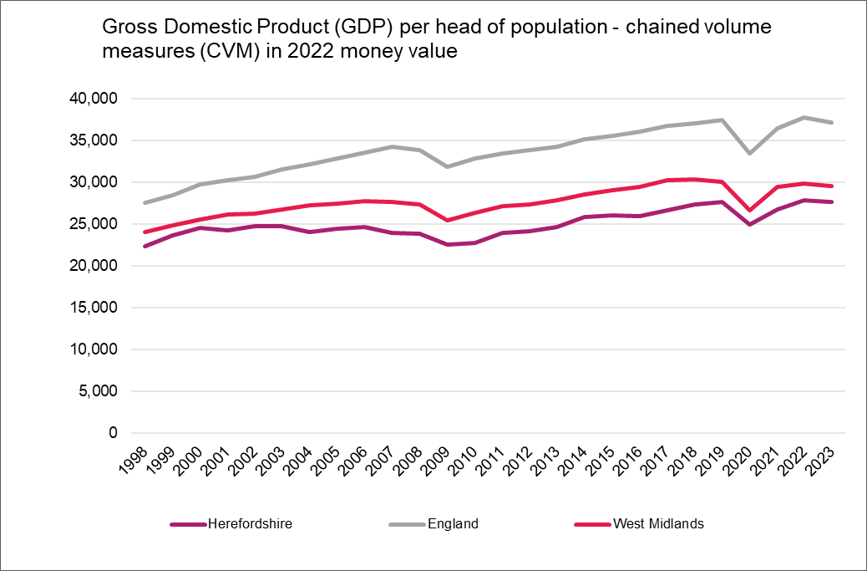
Economic prosperity
Key points
Gross Domestic Product (GDP) is calculated by adding up the total value of goods and services produced, income, or spending and is a key indicator of economic well-being, whereas Gross Value Added (GVA) helps in inter-sectoral economic comparison by comparing the economic standing of sectors like agriculture, manufacturing, and services, GDP facilitates international economic comparison, which compares income levels, living conditions, and the overall financial status of different countries or areas. Using GDP as a measure, the United Kingdom is currently the world’s 6th largest economy, however growth has, by historical and comparative standards, been anaemic since the Financial Crisis of 2008, with population growth (driven primarily by inward net migration) being its biggest contributor. According to Goldman Sachs (briefing 23/02/24), since 2007, the increase in average annual productivity has been just 0.2%, compared to an average of 3.6% in the three decades following World War II. Meanwhile growth in GDP per capita, which is what really matters for living standards, has been particularly poor and here the UK is not amongst the 20 richest countries. ONS estimates that in the three months to December 2025, compared with the three months to September 2025 real GDP grew by 0.1%, after a fall of 0.1% in the three months to November and a fall of 0.1% in the three months to October 2025.
Latest data show that in 2023, Herefordshire’s GDP at current prices was £5,645 million. Adjusting for inflation (chained volume measure), this represented a fall of 0.1 1.3% from the previous year compared to growth of 4.7 % the year before.
In real terms, in 2020 Herefordshire’s economy shrank to its smallest level since 2013 as a result of the pandemic but has now recovered to its largest recorded level. In 2023, per capita GDP at current prices in Herefordshire was £29.729 compared to £40,383 in England and £32,077 in the West Midlands: 26% lower than England and 7% lower than the West Midlands.
Looking at the change over time in real terms, i.e. adjusting for inflation (chained volume measures in 2022 value), per capita GDP in Herefordshire has consistently lagged behind that of both England and the West Midlands region and the gap is currently wider than it was in 1998 (see chart).
Need to know: GDP per capita measures economic output per person and is calculated by dividing the GDP of an area by its population. It is a global measure for gauging the prosperity of nations and is used by economists, along with GDP, to analyse the prosperity of a country based on its economic growth. It allows economists to monitor the productivity of an area with other comparable geographies. This article explains the difference between GDP and GVA.
Data source: ONS
Frequency: Annually
Last updated: 17 April 2025
Next update: t.b.c.

Slide 8
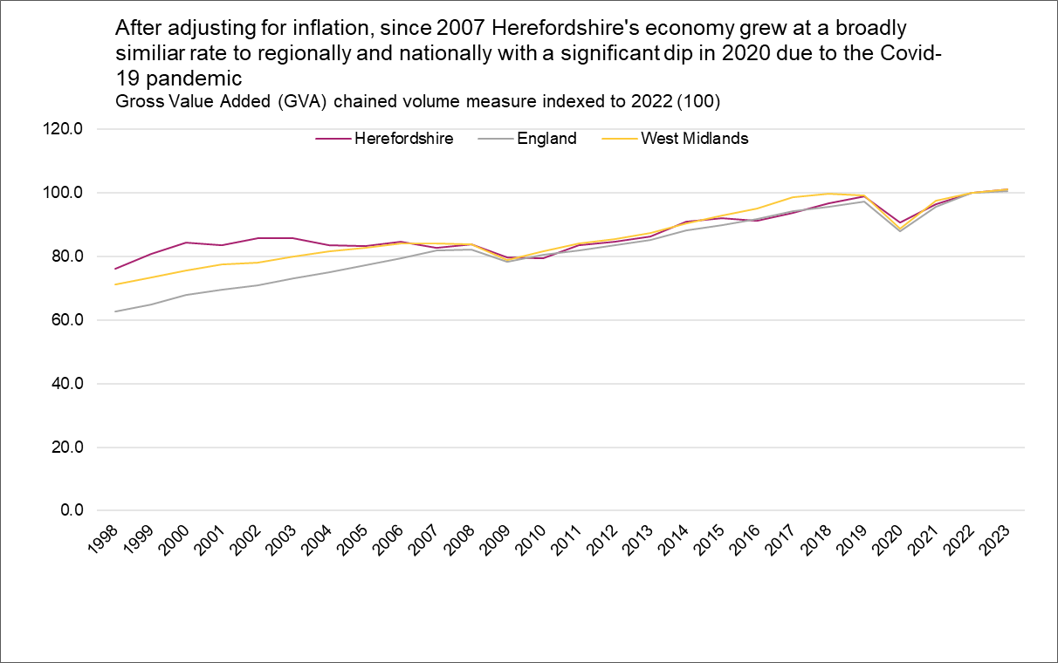
Relative value of the economy over time
A local economy grows when it increases the amount of goods and services it produces. Gross Value Added (GVA) is a way of measuring this output. There is a widely accepted association between economic growth and living standards.
Key points
Since 2007, Herefordshire’s economy has grown at a broadly similar rate to nationally and regionally. Adjusting to remove the effects of inflation (i.e. using the chained volume measure). Since 207, Herefordshire’s economy has grown at a broadly similar rate to regionally and nationally with a significant contraction in 2020 due to the COVID-19 pandemic.
In 2023 (the latest year available), Herefordshire’s total GVA at current prices was £4,927 million. Reflecting the national trend, Herefordshire’s GVA increased by 1.1% in real terms since the previous year.
Need to know: Gross value added (GVA) is the value of goods and services produced in an area, industry, or sector of an economy and is used to measure the value of the economy due to the production of goods and services over time. The data above provide estimates of GVA derived by balancing the income and production approaches to measuring GVA. The dataset includes both current price (nominal or value) and 'real' (chained volume) measures. Using an index value allows us to compare relative growth between different areas. Factors that affect GVA include the size of the population, the proportion of that population who are in employment, demand for labour, and worker productivity (see what works centre for local economic growth - Understanding GVA)
Data source: ONS
Frequency: Annually
Last updated: 17 April 2025
Next update: t.b.c.

Slide 9
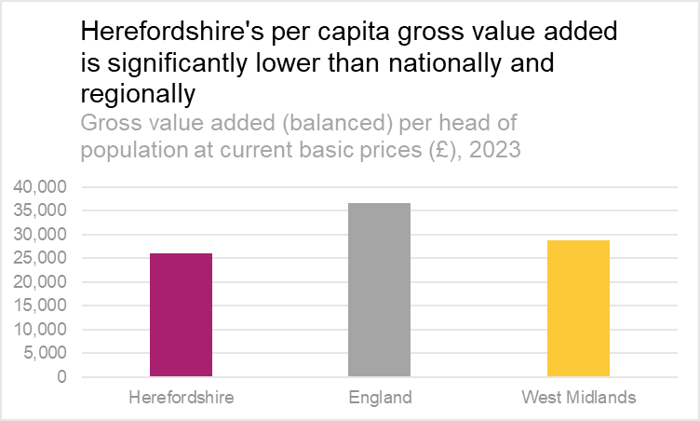
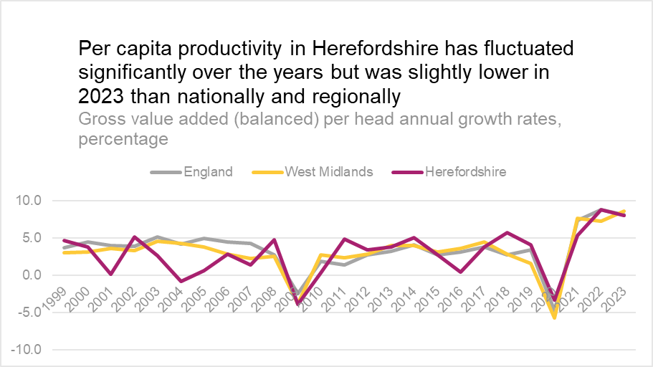
Productivity - per capita Gross Value Added (GVA)
Data source: ONS
Frequency: Annually
Last updated: 17 June 2025
Next update: t.b.c.
Need to know:
Productivity measures are often used to indicate how well a country or area can use its human and physical resources to generate economic growth. Strong economic growth will generally mean an improvement in living standards. However, productivity alone does not tell us everything about the economic wellbeing of different areas. The potential of any given place depends on the mix of industries, the infrastructure and the size of settlements there. Based on these circumstances, even an area with low productivity might be performing as well as it can.
Gross Value Added (GVA) measures the contribution to the economy of each individual producer, industry or sector and is often used as a measure of productivity. Simplistically it is the value of the amount of goods and services that have been produced, less the cost of all inputs and raw materials that are directly attributable to that production.. (Department for Environment, Food & Rural Affairs - Rural productivity and gross value added (GVA))
*ONS advises that 2021 data are not currently available as growth in GDP per head between 2020 and 2021 is unreliable due to a discontinuity in population data for some areas, caused by differences in the timing of census updates.
ONS recommends using GVA per hour worked (see next slide) to measure labour productivity. GVA per hour worked gives a more nuanced measure of labour productivity as it is not so affected by demographic differences between areas.

Slide 10
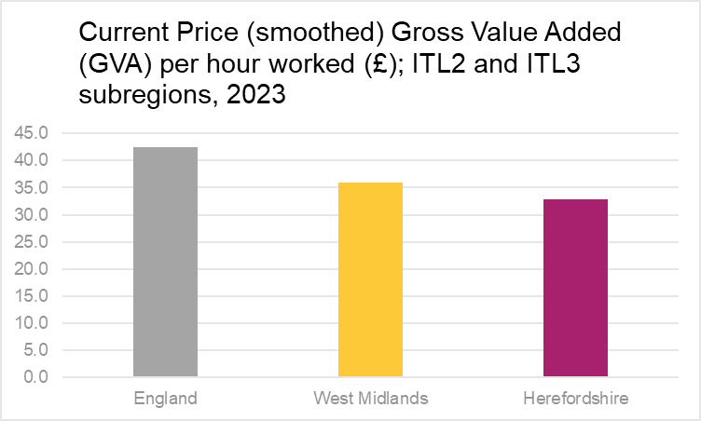
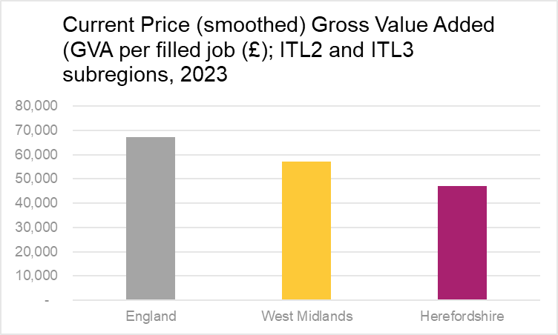
Labour productivity
The level of labour productivity is determined by how efficiently and effectively labour is utilized in an economy. Comparing the labour productivity of different areas provides an indication of relative competitiveness. Labour productivity is one of the key determinants of wages and poor labour productivity is a barrier to social mobility.
Key points
Research by the London School of Economics (LSE) published in November 2023 found that UK productivity is lower than in France, Germany and United States – and almost all of this gap is due to a lack of investment in capital and skills. Research by the University of Birmingham (January 2023) found that the West Midlands has one of the largest inter-regional gaps in productivity in the UK, with its most productive sub-region (Solihull) producing £21.50 (47%) per hour more than its least productive sub-region (Herefordshire).
In 2023, Herefordshire GVA per hour worked (smoothed*) was £32.9: significantly lower than England (£42.4) and the West Midlands (£36.0).
Similarly, Herefordshire’s GVA per filled job (smoothed*) in 2023 was £47,116, compared to £67,338 for England and £57,024 for the West Midlands.
Using the GVA per hour worked measure, in 2023 Herefordshire had one of the lowest levels labour productivity of any International Territorial Level (ITL) 3 area of the UK, ranking 164th out of 182. In England only, it ranked 127th out of 141. The reasons for this are complex but are likely related to Herefordshire’s rurality and the associated composition of its economy. The Midlands Engine Intelligence Hub contains a useful GVA for Small Areas map which can be used to compare local authority areas.
Need to know: Gross value added (GVA) measures the contribution made to an economy by one individual producer, industry, sector or region. The figure is used in the calculation of gross domestic product (GDP) – University of Birmingham *Data are smoothed using a weighted 5-year moving average.
ONS provide two measures of labour productivity. The first is a ratio of output (measured as gross value added (GVA)) divided by the hours worked to create it. The second measure divides GVA by the number of filled jobs used to create it. In both cases, GVA is an estimate of the total amount of goods and services produced less the value of intermediate inputs. GVA per hour worked is the preferred measure of labour productivity. More information.
Data source: ONS Subregional Productivity
Frequency: Annually
Last updated: 19 June 2025
Next update: June 2026

Slide 11
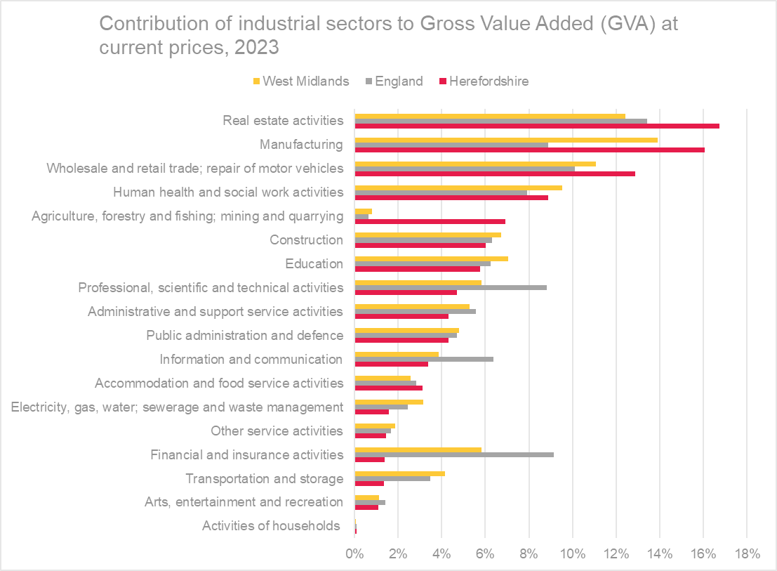
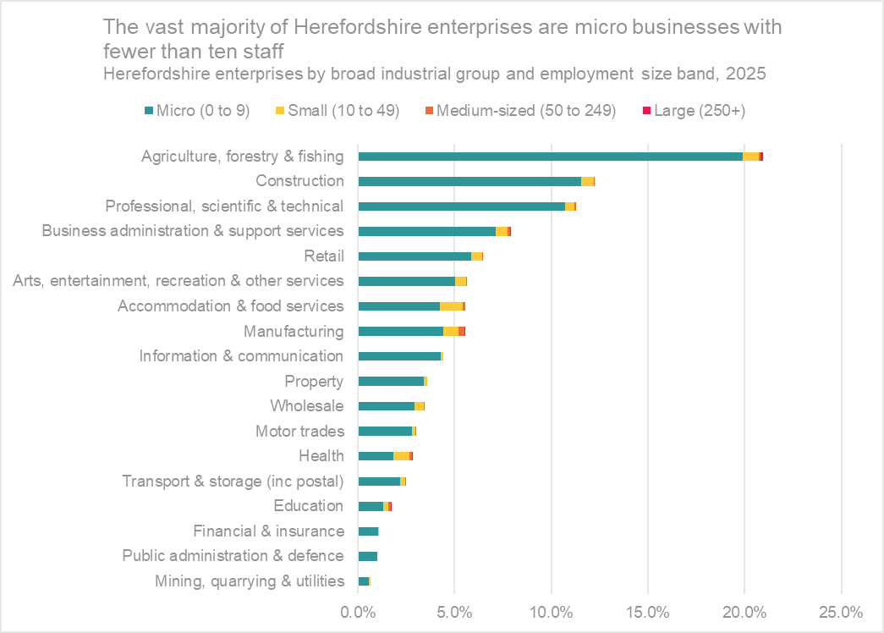
Numbers of businesses (enterprises) by industry and size, and contribution to the value of economic output by industry
Data source: ONS – NOMIS
Frequency: Annually
Last updated: 14 October 2025
Next update: Autumn 2026
Key point:
The structure of Herefordshire’s economy is significantly different to nationally and regionally, largely due to the rurality of the county, with agriculture, real-estate activities and manufacturing accounting for a greater proportion of economic output and financial and insurance activities and information and communication much less.
Data source: ONS
Frequency: Annually
Last updated: 17 April 2025
Next update: April 2026

Slide 12
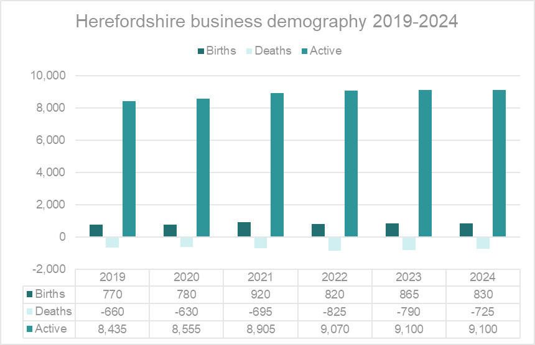
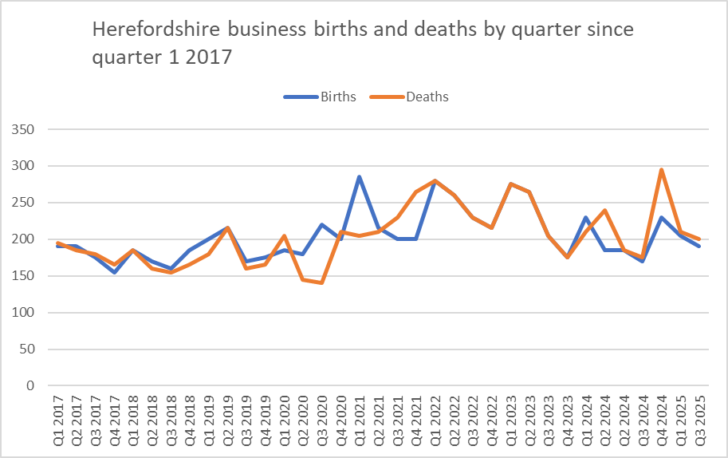
Business demography
Data source: ONS
Data last updated: 30 October 2025
Frequency: Quarterly
Next update: t.b.c.
Data source: ONS
Data last updated: 20 November 2025
Frequency: Annually
Next update: t.b.c.
Need to know:
Birth - identified as a business that was present in year t,but did not exist in year t-1 or t-2. Births are identified by making comparison of annual active population files and identifying those present in the latest file, but not the two previous ones.
Death - defined as a business that was on the active file in year t,but was no longer present in the active file in t+1 and t+2. In order to provide an early estimate of deaths, an adjustment has been made to the latest two years deaths to allow for reactivations. These figures are provisional and subject to revision.
Active - These are defined as businesses that had either turnover or employment at any time during the reference period.
Business birth, death and survival rates vary by industry, with the transport and storage (including postal) industry having had both the highest birth and death rates nationally since 2018 (ONS). Business survivals are not necessarily good, as the continued survival of so-called ‘zombie companies’ inhibits productivity and growth. Similarly, business deaths can be good for an economy if jobs and resources are recycled into more dynamic and productive firms.

Slide 13
Business survival rates and high-growth enterprises
In 2024, the West Midlands had the lowest 5-year business survival rate of any UK region (30.6%). There were 1,000 high-growth businesses in the West Midlands in 2024, up 4.2% from 2023 (ONS).
Key points
The one-year survival rate for new-born Herefordshire enterprises declined from 96.8% in 2019 to 91.3% in 2023. There were similar falls in 2, 3 and 4-year survival rates. A similar trend can be observed nationally and regionally.
In 2019, the 1-year survival rate was higher in Herefordshire than nationally and regionally, however by 2023 it was lower.
In 2019 the 2-year survival rate was 7.1 percentage points higher than nationally and 11.4 percentage points higher than regionally. By 2022 this difference had fallen to 3.7 and 7.7 percentage points respectively.
In 2019, the five-year survival rate for Herefordshire businesses (50.0%) was significantly higher than nationally (38.3%) and regionally (30.6%).
In 2023, there were 45 active high-growth enterprises* in Herefordshire, up from 30 in 2019.
Need to know
There are several different methods of measuring high growth. ONS has used this definition: All enterprises with average annualised growth greater than 20% per annum, over a three-year period. Growth can be measured by the number of employees or by turnover. For this analysis growth has been measured using employment. It is also recommended that a meaningful size threshold be set to avoid the growth of small businesses distorting any results. Eurostat have provisionally set a starting threshold of 10 employees
Data source: ONS
Data last updated: 20 November 2025
Frequency: Annually
Next update: t.b.c.

Slide 14
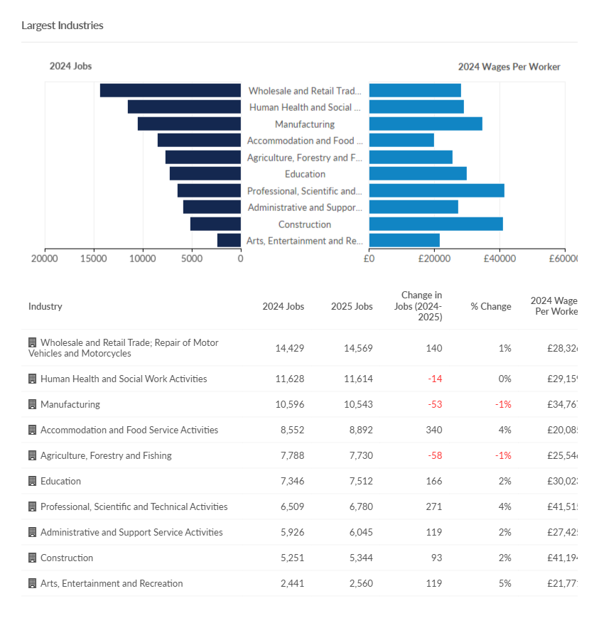
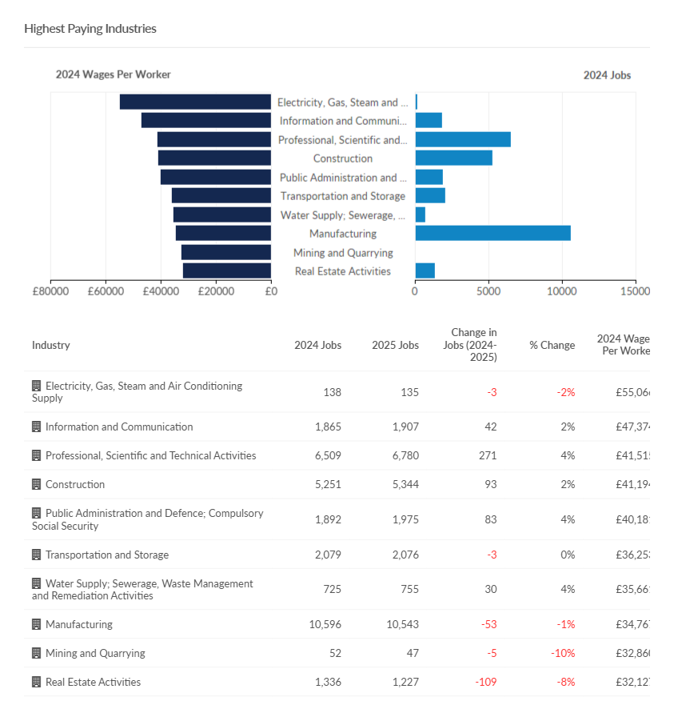
Largest and highest paying industries
Need to know: The charts show occupations at Standard Industry Classification (SIC) 1 level but data are available down to SIC 4 level if more granularity is required.
Source: Lightcast (EMSI): economicmodelling.co.uk
Date last updated: April 2025
Frequency of update: Annually
Next update: April 2026

Slide 15
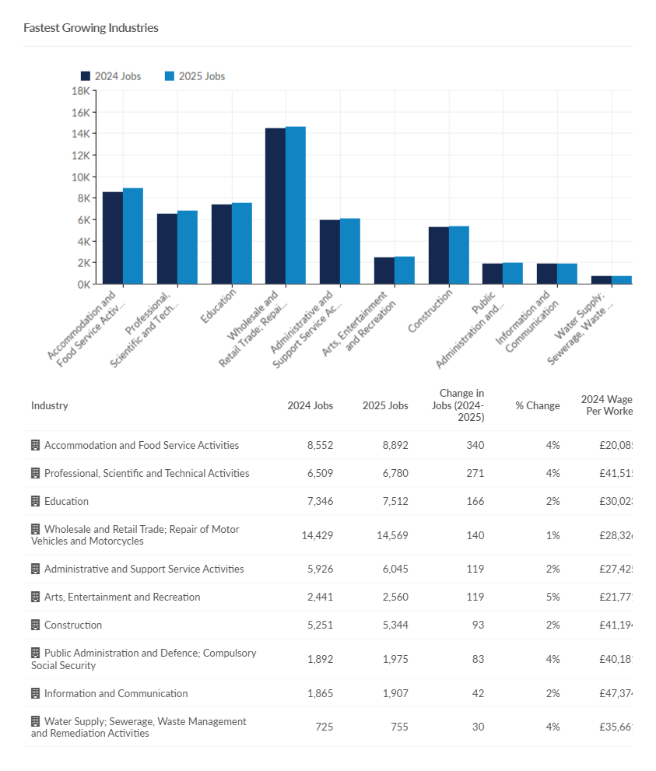
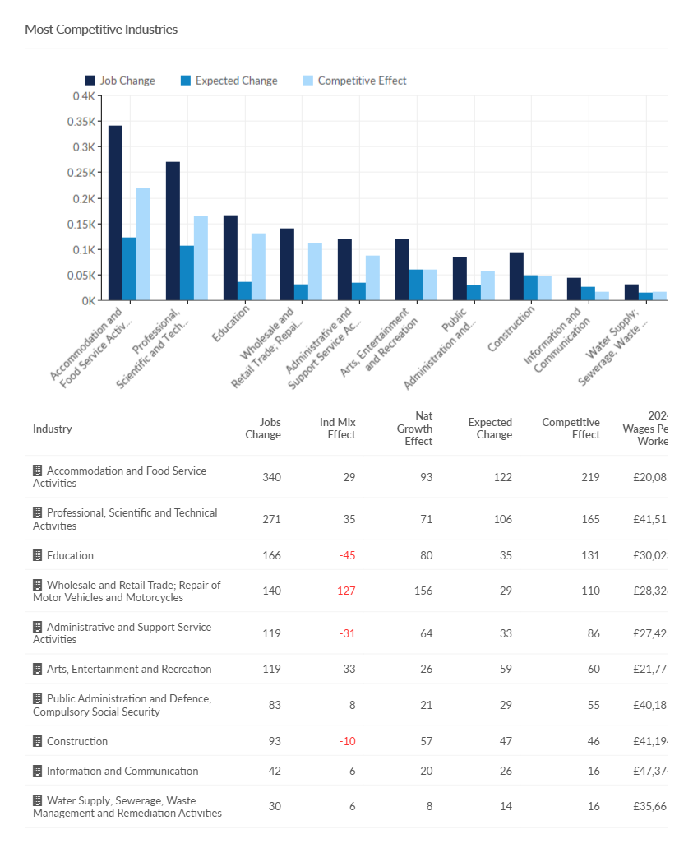
Fastest growing and most competitive industries
Need to know:
Competitive effect indicates how much of the job change within a given region is the result of some unique competitive advantage of the region. This is because the competitive effect, by definition, measures the job change that occurs within a regional industry that cannot be explained by broader trends.
The charts show occupations at Standard Industry Classification (SIC) 1 level but data are available down to SIC 4 level if more granularity is required.
Source: Lightcast (EMSI): economicmodelling.co.uk
Date last updated: April 2025 Frequency of update: Annually
Next update: April 2026

Slide 16
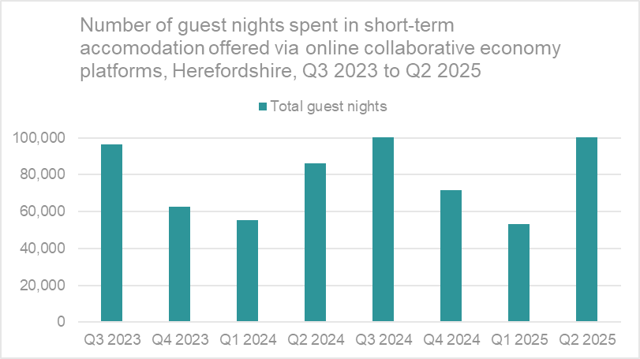
Visitor economy
Key points
According to the latest GTS STEAM report, tourism was worth £773.74 million to Herefordshire’s economy in 2024, 5.90 million visitors spending 8.05 million visitor days in the county supporting 7,965 jobs.
Data from Lightcast suggest that the visitor economy is a strength for Herefordshire, directly employing c.2,700 people in 2023; 42% above the national average. However, average wages per job in the sector are significantly lower than the national average (£23,176 p.a. vs £24,399 p.a.).
In Herefordshire in the year from Q3 2024 to Q2 2025 there were over 337,670 guest nights spent in short-term lets offered via online collaborative economy platforms (Airbnb, Booking.com and Expedia Group). This represented a 12.3% increase from the previous year (300,570 from Q3 2023 to Q2 2024).
The volume of stays across the year is strongly affected by the seasons with August the most popular month for short-term lets. There is also significant geographical variation. For more information see ONS Short-term lets through online collaborative economy platforms, UK.
Need to know: Short-term lets refers to rentals, such as apartments or rooms, booked through these three platforms, excluding other forms of accommodation, such as hotels or campsites.
Number of guest nights = The number of nights spent during a stay, with a night counted per individual member of the visiting group. This can be influenced by guest group size and length of stay. For example, a family of four staying for 2 nights would be 8 guest nights, but 2 nights and 1 stay.
Data source: ONS
Date last updated: 28 November 2025
Frequency of update: Biannually
Next update: May 2026

Slide 17
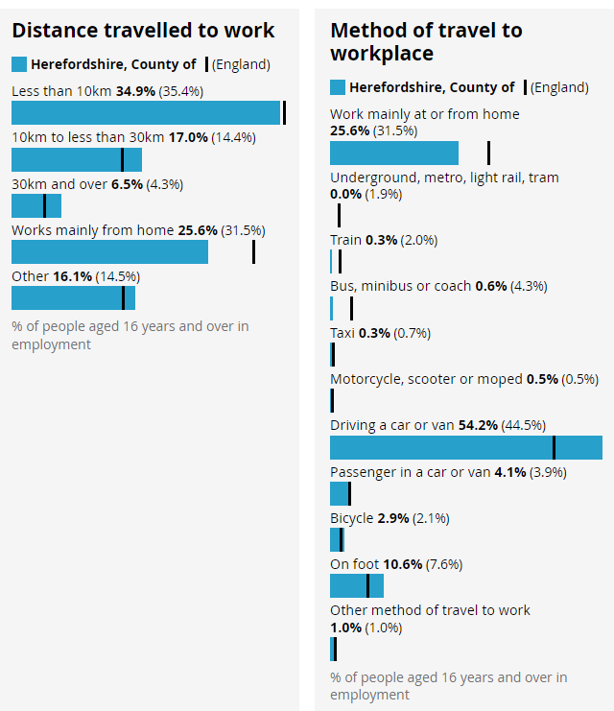
Distance travelled to work and method of travel
Key points
The frequency of, and ways in which, people travel to and from work has implications not only for the environment and health and wellbeing but for household budgets, for some in terms of transport costs, and for others, in terms of home heating costs.
Herefordshire in one of England’s most rural counties and is relatively lacking in public transport infrastructure with only four railway stations (Colwall, Hereford – Barr’s Court, Ledbury and Leominster). Almost two thirds of all Herefordshire LSOAs (72 out of 116) are among the 25% most deprived in England in respect to geographical barriers to services with 53 being in the most deprived 10% across England. Of these three quarters are in rural areas.
The 2021 Census provides information about distance travelled to work and mode of transport. Because of the Covid-19 pandemic, and because the ONS widened the age range (from 16-74 in 2011 to 16 and over in 2021), is not appropriate to compare the 2021 results with 2011.
The ONS Subnational Indicator Explorer shows Herefordshire to be worse than the average for all local authorities in respect of average travel time to employment centre by bicycle, average travel time to employment centre by car, and average travel time to nearest employment centre by public transport or walking.
In 2021, of all people aged 16+ in employment, although a similar proportion travelled less than 10 kilometres to work as nationally (34.9 vs 35.4%), a greater proportion travelled 10–30 kilometres to work (17.0% vs 14.4%). The proportion who travelled 30 or more kilometres is also higher (6.5% vs 4.3%).
Not only did a greater proportion of people travel longer distances to work than nationally, a higher proportion did so in a car or van (58.3% vs 48.4), which is to be expected given the longer distances involved, and relative lack of public transport.
A lower proportion of people worked from home than nationally (25.6% vs 31.5%), which is to be expected given the occupation profile of the county.
Source: ONS
Last updated: 8 December 2022
Frequency: Decennially
Next update: 2031
Need to know: Lower Super Output Areas (LSOAs) are fixed statistical geographies of about 1,500 people designed by the Office for National Statistics (ONS).
On the Census 2021 form, people who were in employment or temporarily away from work in the week before Census Day were asked "How do you usually travel to work?". People were asked to select one mode of transport that they used for the longest part, by distance, of their usual journey to work. With regard to the above proportions, it should be noted that the Census was undertaken when COVID measures were still in place, so these are likely to have changed significantly since.

Slide 18
Digital exclusion
Digital exclusion is a barrier to employment and educational opportunities, social networking and access to everyday services and thus has a range of negative impacts on affected individuals. People may be digitally excluded for multiple reasons, including not having access to the required infrastructure and/or devices, lack of skills, or lack of motivation to use technology.
According to research by Lloyds Bank,.95% of UK adults were online in 2025, up 6.3 million since 2016 and 38% of people have increased their digital engagement since 2020. For those not yet fully engaged, the biggest motivators were around affordability: 1 in 3 said cheaper devices would encourage them, while nearly half (48%) wanted more control over their personal data, and 40% said increased online security awareness. There’s also an opportunity to close a knowledge and skills gap. Over a third said help from friends or family would make a difference, while others cited a better understanding of the benefits of being online and better access through simpler website/app design and mobile signal coverage would make a difference.
Research has found that without internet access, consumers can pay as much as 25% more for essential goods and services, while pressures on household budgets have forced many to cancel broadband contracts.
. Key points
The proportion of adults in Herefordshire who are either lapsed or non-internet users has declined in recent years in line with the trend nationally. There was an increase in 2020 although this was not statistically significant. In 2020, ONS estimated that there were around 17,000 adults (age 16+) in Herefordshire who don’t use the internet.
The 2023 Community Wellbeing Survey found that 88% of Herefordshire adults regularly accessed the internet for non-work purposes: similar to 2021 (89%). 12% did not use it regularly, similar to 2021 (10%), and this proportion rose for people living in the most deprived locations (19%), aged 65+ (25%), and with no formal educational qualifications (41%). Asked why, 44% said it was because they didn’t need it, however 31% said they didn’t have the skills, rising to 48% amongst Housing Association tenants.
While 35% of people said their use of the internet had increased since that start of the COVID-19 pandemic, for 5% it had reduced, rising to 12% among those in the most deprived locations, 11% amongst Housing Association tenants and 12% of people with an ethnic minority background.
41% of people were positive about more things being provided online: a 17 percentage point decrease from 2021 (58%). 35% were concerned about more things being provided online: an increase of 13 percentage points from 2021. The proportion was higher amongst those aged 55+ (46%), the economically inactive (44%) (likely driven by age), people with no formal educational qualifications (43%), those with a disability (43%) or those who receive care (43%), and those who do not use the internet regularly (54%).
The 2022 Telecare Users’ Survey found that 49% of users in Herefordshire did not use the internet (down slightly from 52% in 2019), 36% of Telecare users said they were not confident using the internet.
Greater Manchester Office of Data Analytics at Greater Manchester Combined Authority has produced a Digital Exclusion Risk Index for Great Britain, which shows that overall, Herefordshire has a low digital exclusion risk but with pockets of higher risk in Ledbury South and Golden Valley South Lower Super Output Areas (LSOAs).

Slide 19
Section 2: The labour market

Slide 20
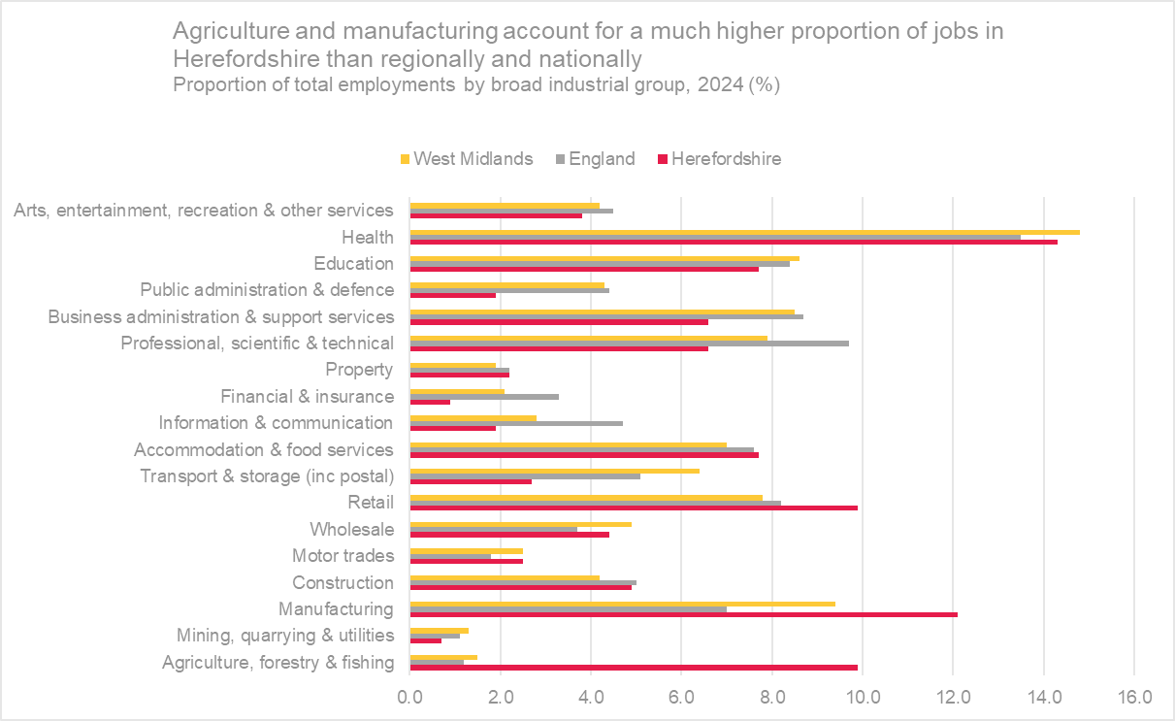
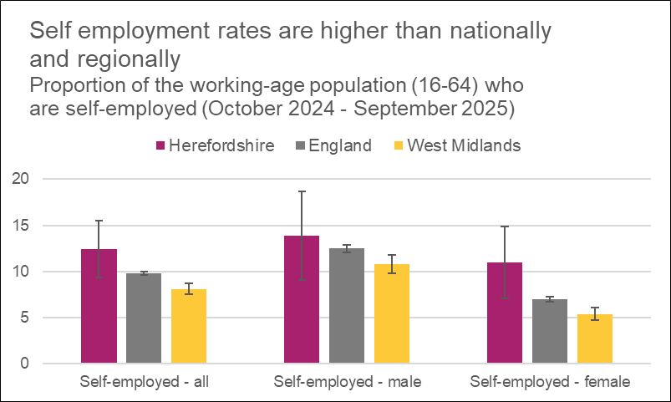
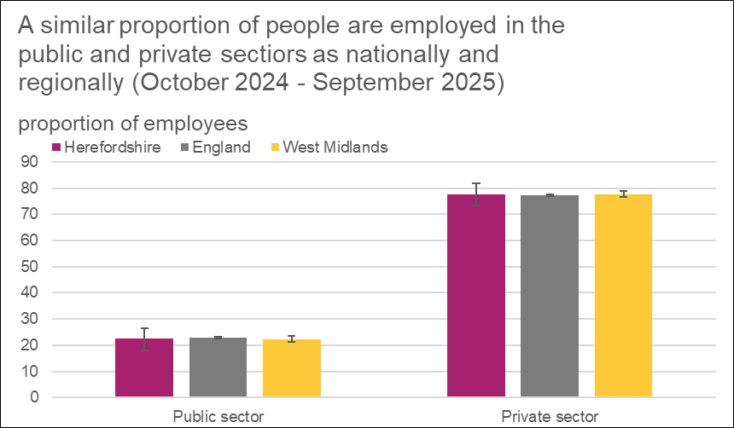
Distribution of jobs
Data source: ONS – NOMIS
Frequency: Quarterly
Last updated: 20 January 2026
Next update: April 2026
Data source: ONS – NOMIS
Frequency: Annually
Last updated:28 October 2025
Next update: Autumn 2026
Key points:
A much higher proportion of jobs are in agriculture and manufacturing than nationally. A greater proportion of people are self-employed than nationally. Most jobs are in the private sector.
Data source: ONS – NOMIS
Frequency: Quarterly
Last updated: 20 January 2026
Next update: April 2026
Need to know: Employment includes employees plus the number of working owners. BRES therefore includes self-employed workers as long as they are registered for VAT or Pay-As-You-Earn (PAYE) schemes. Self employed people not registered for these, along with HM Forces and Government Supported trainees are excluded. Working owners are typically sole traders, sole proprietors or partners who receive drawings or a share of the profits.

Slide 21
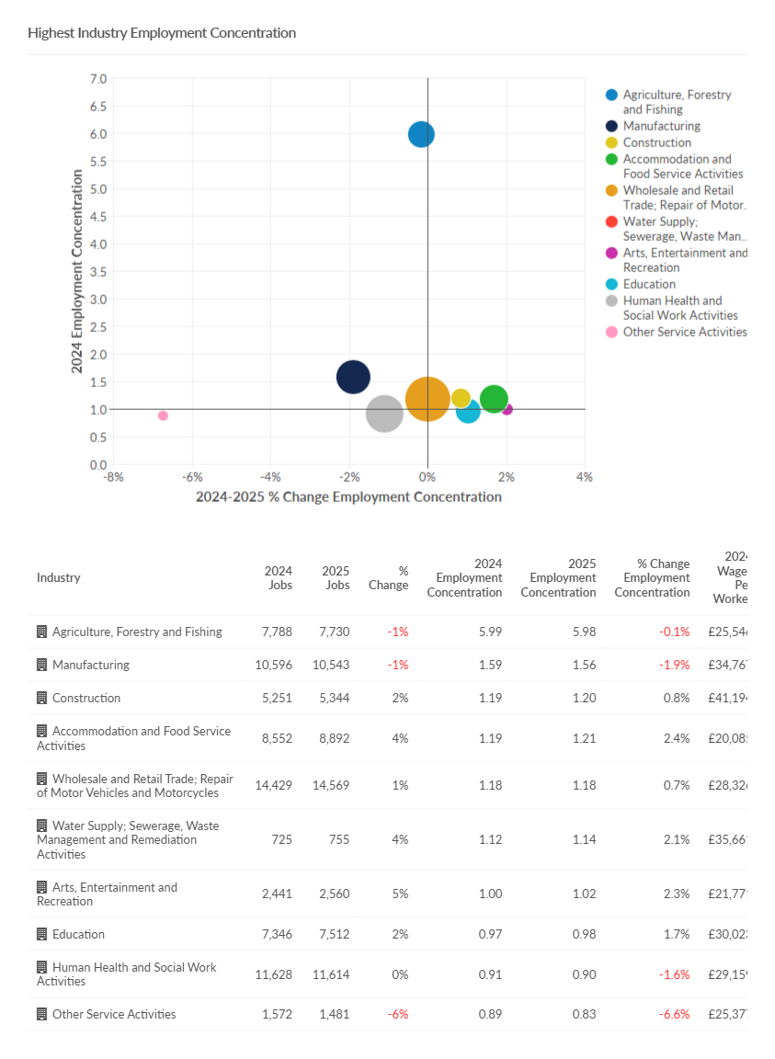
Highest industry employment concentrations
Need to know: The charts show occupations at Standard Industry Classification (SIC) 1 level but data are available down to SIC 4 level if more granularity is required.
Source: Lightcast (EMSI): economicmodelling.co.uk
Date last updated: April 2025
Frequency of update: Annually
Next update: April 2026

Slide 22
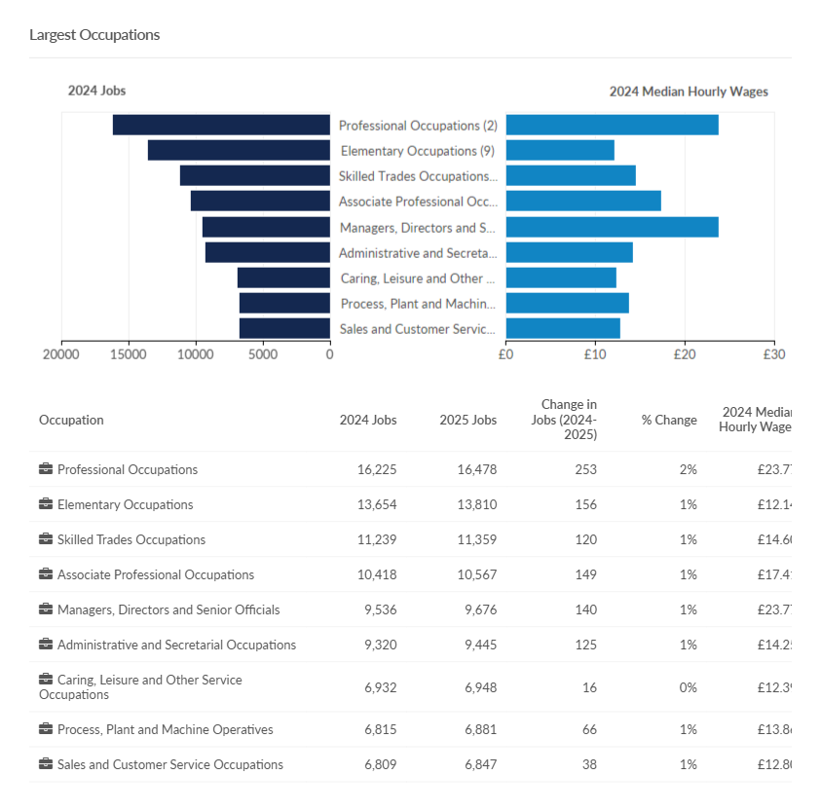
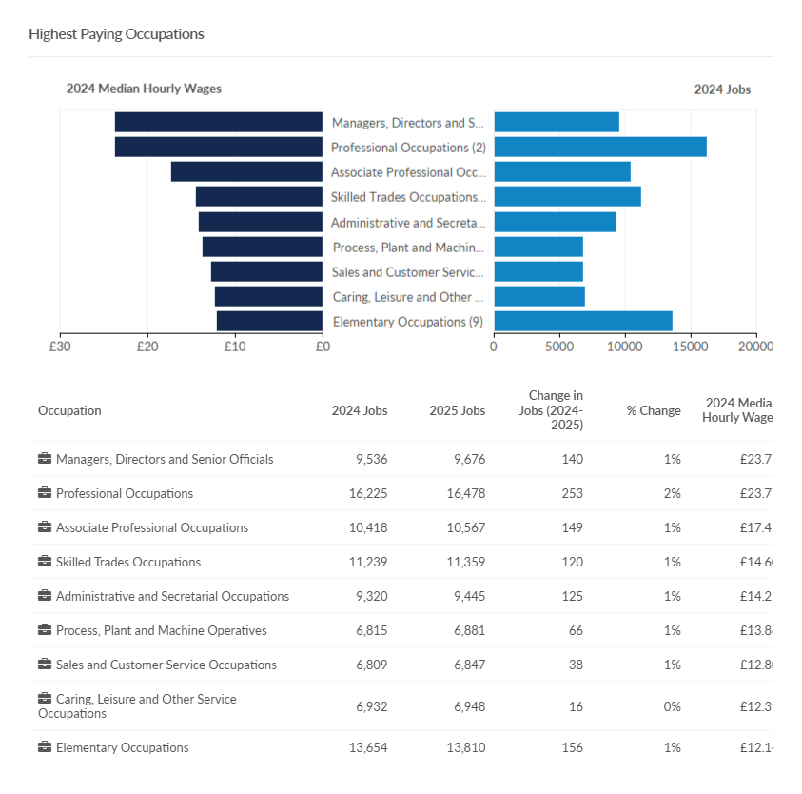
Largest and highest paying occupations
Need to know: The charts show occupations at Standard Occupation Classification (SOC) 1 level but data are available down to SOC 4 level if more granularity is required.
Source: Lightcast (EMSI): economicmodelling.co.uk
Date last updated: April 2025
Frequency of update: Annually
Next update: April 2026

Slide 23
Fastest growing and most competitive occupations
Need to know:
Competitive effect indicates how much of the job change within a given region is the result of some unique competitive advantage of the region. This is because the competitive effect, by definition, measures the job change that occurs within a regional industry that cannot be explained by broader trends.
The charts show occupations at Standard Occupation Classification (SOC) 1 level but data are available down to SOC 4 level if more granularity is required.
Source: Lightcast (EMSI): economicmodelling.co.uk
Date last updated: April 2025
Frequency of update: Annually
Next update: April 2026

Slide 24
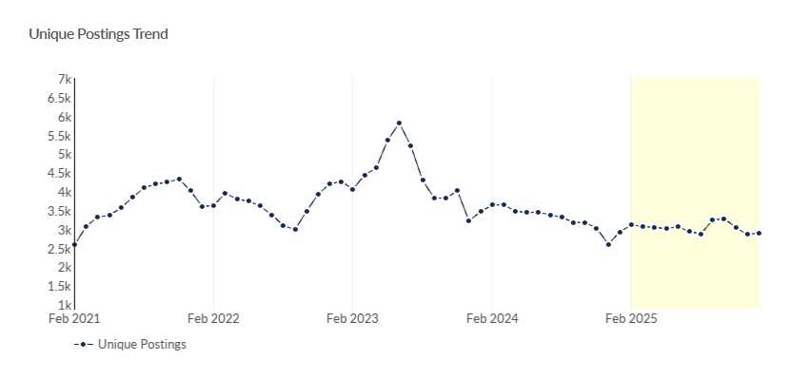
Job postings
Key points
In Herefordshire, the number of job postings has been slowly declining month-on-month since February 2025 excepting a modest rise in September. Over the period from February 2025 to January 2026 there were 37,062 job postings, of which 19,257 were unique. The number of unique posting in January 2026 was slightly higher than in December 2025: 2,900 compared to 2,855 (revised), similar to a year ago (2,922 in January 2025) and remains well below the 5-year peak of 5,810 in June 2023.
The top ten posted occupations (SOC 3 level) in the period from February 2025 to January 2026 were caring personal services (1,073 unique postings), other elementary service occupations (1,065), teaching professionals (995) and sales related occupations (834). Top posted job titles in this period were support workers (504 unique postings), cleaners (271), production operatives (176) and health care assistants (147),
Source: Lightcast (EMSI): economicmodelling.co.uk
Date last updated: 2 February 2026
Frequency of update: Monthly
Next update: March 2026
Need to know: A unique job posting is one that has been de-duplicated as postings can appear on multiple websites, multiple times. Data include voluntary, internships, side jobs and freelance.
The Standard Occupational Classification (SOC) is a common classification of occupational information for the UK and comprises 4 tiers with 4 being the most detailed.

Slide 25
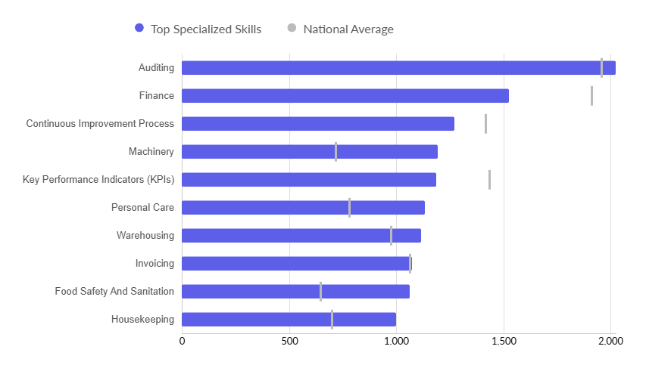
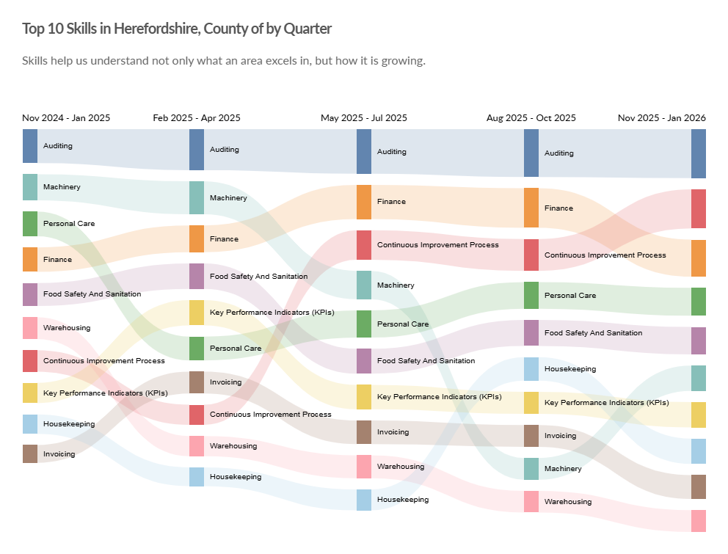
In-demand skills
Top hard skills
Top 10 hard skills by quarter
Need to know: Hard skills are abilities that have been taught to or learnt by a person.
Source: Lightcast (EMSI): economicmodelling.co.uk
Date last updated: 2 February 2026
Frequency of update: Monthly
Next update: March 2026

Slide 26
Hard to fill vacancies
Key points
CIPD reports that nationally, the labour market continues to cool, with official data published in February 2026 showing hiring intentions at historically low levels outside the pandemic and only 15% of employers anticipate significant recruitment difficulties in the next 6 months. 30% of employers reported hard-to-fill vacancies in the latest quarter with anticipated problems filling vacancies in the next 6 months remaining high among employers in compulsory education (72%), care and social work (62%), and healthcare (59%).
There is no standard definition of a “hard-to-fill” vacancy and no equivalent survey to that undertaken by CIPD at local level, but the table shows those occupations (SOC 3 level) for the period February 2025 to January 2026 with an above average posting intensity and an above average median posting duration, which represent those likely to have been the most difficult to fill.
This is the timeliest proxy for “hard-to-fill” vacancies and although there are some issues associated with this methodology, it has been shown to be a robust approximation.
Occupation | Avg. Posting Intensity (Feb 2025 - Jan 2026) | Median Posting Duration from Feb 2025 - Jan 2026 | Unique Postings from Feb 2025 - Jan 2026
Health and Social Services Managers and Directors | 5 : 1 | 23 | 105
Conservation and Environment Professionals | 4 : 1 | 29 | 11
Therapy Professionals | 3 : 1 | 23 | 242
Finance Professionals | 3 : 1 | 28 | 296
Welfare Professionals | 3 : 1 | 30 | 760
Regulatory Associate Professionals | 3 : 1 | 23 | 96
Vehicle Trades | 3 : 1 | 23 | 146
Skilled Metal, Electrical and Electronic Trades Supervisors | 3 : 1 | 29 | 72
Caring Personal Services | 3 : 1 | 24 | 1,073
Elementary Sales Occupations | 3 : 1 | 22 | 65
Need to know: Posting Intensity is a ratio of total job postings to unique, or de-duplicated, job postings. An above average posting intensity can mean that employers are putting more effort than normal into hiring that position. Posting intensity is available by occupation, by job title, by company, and by region. The median posting duration (how long a posting was live before it was taken down) can be compared to the regional average for all postings in the region, giving an indication of whether these positions are harder or easier to fill than the typical job posting.
Source: Lightcast (EMSI): economicmodelling.co.uk
Date last updated: 2 February 2026
Frequency of update: Monthly
Next update: March 2026

Slide 27
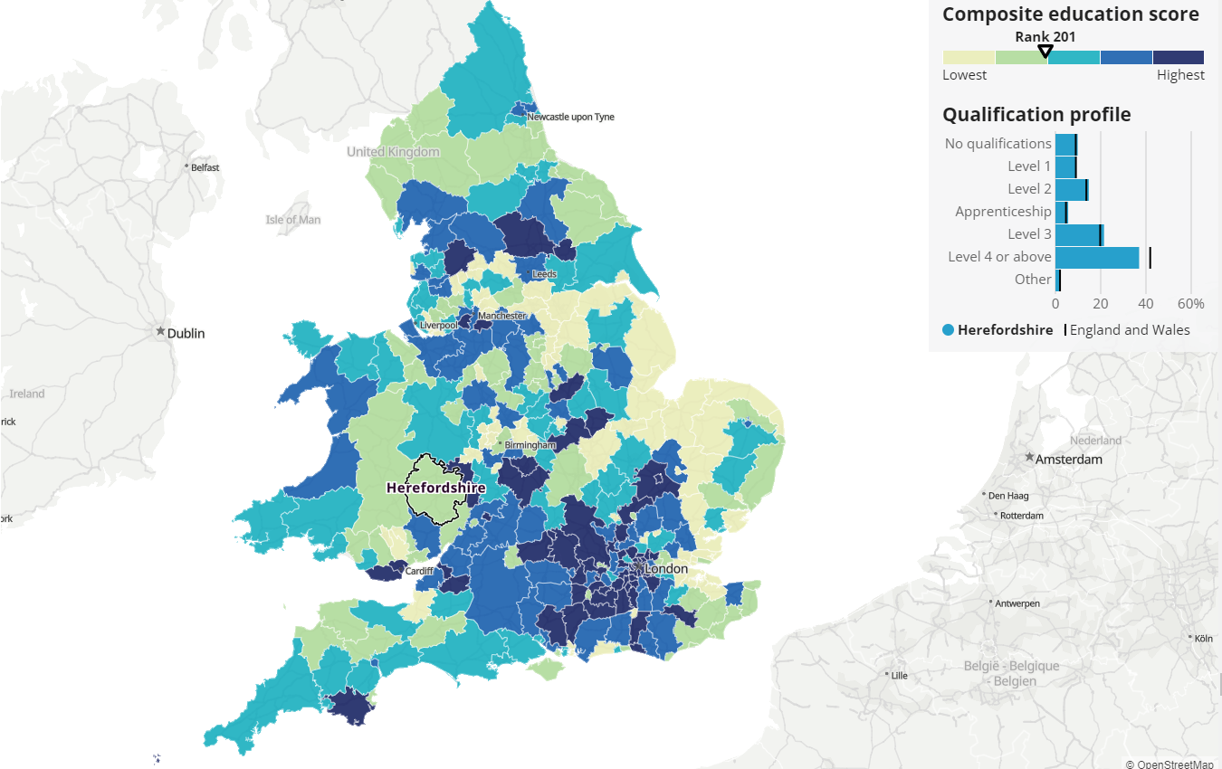
Workforce qualifications
Nationally, over 200,000 16-year-olds leave school without GCSEs in English and maths every year and an estimated nine million working-age adults in England have low literacy and numeracy skills. Lacking these gateway qualifications locks people out of many opportunities for education and employment and is associated with many adverse outcomes for earnings potential, health, and wellbeing (Get Further). Qualification levels vary markedly by socio-economic group and age (IFS, 2022).
Census 2021 data also show that education levels among local labour forces vary between areas in England and Wales. This matters, because it can indicate the quality of locally available jobs, whether they require higher levels of education and whether they are higher-paid. Areas with good educational attainment, opportunities and job markets are likely to have a richer local economy. Meanwhile, areas with a less-qualified workforce might have fewer job opportunities for highly qualified people, struggle to train or attract and keep qualified workers, and have a poorer local economy. All of this has cost-of-living implications.
Key points
Using ONS’s composite education score methodology, Herefordshire is ranked 201 out of 331 English and Welsh local authorities. This puts it in the bottom 40% of areas.
The five most similar areas to Herefordshire in terms of qualification profile are: 1. Gateshead 2. Ryedale 3. Kirklees 4. Powys 5. Calderdale. The most similar area, Gateshead, was ranked eight places higher than Herefordshire.
ONS Annual Population Survey data for the period January to December 2024 show that 44.0% (+/-5.0) of the working-age population in Herefordshire were qualified to RQF level 4 or above, compared to 46.8% (+/- 0.4) for England and 42.9% (+/-1.2) for the West Midlands. 3.4% (+/-1.8) had no qualifications, compared to 6.6% (+/-0.2) in England and 8.3% (+/-0.7) in the West Midlands. Herefordshire was not therefore statistically significantly different from either England or the West Midlands region in respect of RFQ4+ but was significantly lower in the proportion of the working-age population with no qualifications.
Source: ONS
Frequency: Decennially
Last Updated: 17 February 2023
Next update: 2033
Need to know: For information on how the composite education score was derived see ONS: How workforce qualification levels differ across England and Wales, technical annex: Census.
RQF = Registered Qualifications Framework

Slide 28
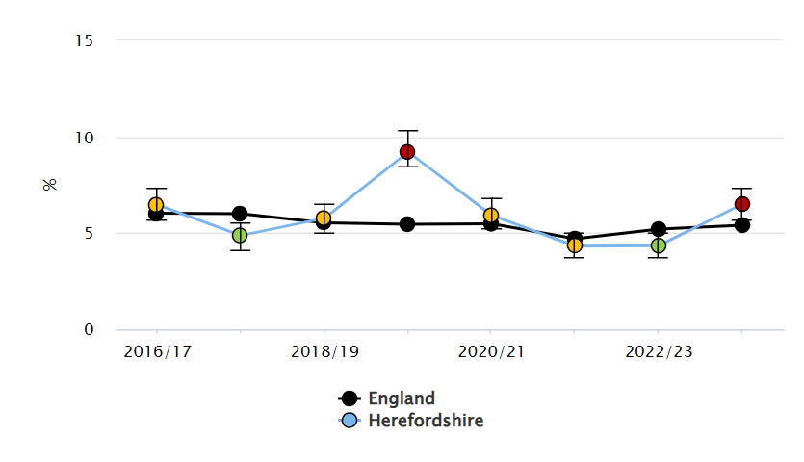
Young people not in Education, Employment or Training (NEET)
The Scottish Longitudinal NEET Study (2015) found that young people who are NEET suffer long-lasting and cumulative detrimental effects:
NEETs remained disadvantaged in their level of educational attainment 10 and 20 years later. More than one in five of NEET young people in 2001 had no qualifications in 2011, compared with only one in twenty-five of non-NEETS.
There is a 'scarring effect' on economic activity. In comparison with their non-NEET peers, NEET young people in 2001 were 2.8 times as likely to be unemployed or economically inactive 10 years later. The scarring effect is also evident in the occupational positions that NEET young people take up, if they entered employment. For example, NEET young people in 2001 were 2.5 times as likely as their non-NEET peers to work in a low status occupation in 2011, if they found work.
NEET experiences are associated with a higher risk of poor physical health after 10 and 20 years. The risk for the NEET group was 1.6-2.5 times that for the non-NEET group, varying with different health outcomes. NEET experiences are also associated with a higher risk of poor mental health after 10 and 20 years. The risk of depression and anxiety prescription for the NEET group is over 50% higher than that for the non-NEET group.
According to ONS data, an estimated 12.7% of all people aged 16 to 24 years in the UK were not in education, employment or training (NEET) in July to September 2025. This was down 0.1 percentage points compared with April to June 2025, and down 0.3 percentage points on the year. There were 946,000 young people who were NEET in total, a decrease of 1,000 on the quarter. A House of Commons report in November 2025 found that the NEET rate has been rising since 2021 with the current level close to the highest since 2014. 61% of young people who were NEET in April to June 2025 were economically inactive while only 39% were unemployed. Contrary to the historical picture, since 2016 there have generally been more young men who are NEET than young women.
Key points
In 2023-24, Herefordshire’s NEET/not known rate for 16-17-year-olds was 6.5%, significantly higher than in 2022-23 (4.3%) and was significantly higher than in England (5.4%). It was also higher than in the West Midlands (6.1%) but not significantly so (see chart).
The number of NEETs and not knowns varies significantly month-on-month, the annual rate data are an average of the figures submitted by to the DfE for the months of December, January, February each year.
The proportion of young people who are NEET or not known in Herefordshire had fallen recently from a peak of 9.2% in 2019-20.
The rate of 16 to 17-year-olds who were NEET or whose status was not known increased significantly in 2023-24 and was higher than nationally.
Chart 1 image copyright: Office for Health Improvement & Disparities. Public Health Profiles. [Date accessed: 20 November 2023] https://fingertips.phe.org.uk © Crown copyright [2023]. Source (chart 1): .Department of Health & Social Care - Fingertips, Last updated: November 2023, Next update: T.b.c.. Data source (chart 2): Herefordshire Council Children and Young People Directorate, Frequency: Annually, Last updated: May 2025, Next update: May 2026.

Slide 29
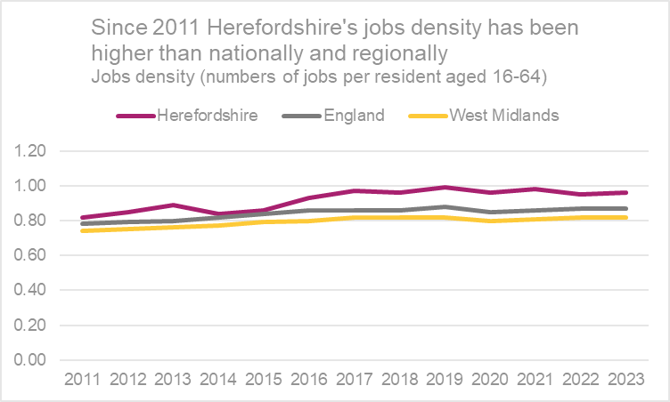
Jobs density
Job density is a measure of labour demand in an area. It shows the supply of jobs relative to the size of the working-age population. A higher job density can be suggestive of a high proportion of people being employed locally, or (less likely in the case of Herefordshire) large numbers commuting into an area to work.
Key points
In 2023 (the latest available year), jobs density in Herefordshire (0.96) was similar to 2022 (0.95) and higher than in England (0.87) and the West Midlands (0.82). Since 2011 Herefordshire’s jobs density has consistently been higher than nationally and regionally..
Need to know: Jobs density is the number of jobs in an area divided by the resident population aged 16-64. For example, a job density of 1.0 would mean that there is one job for every resident aged 16-64. Jobs density is based on a workplace-based measure of jobs that comprises employee jobs, self-employed, government-supported trainees and HM Forces. In areas with high jobs densities the demand exceeds the supply, and the imbalance may be satisfied by workers who live outside the area (inward commuting). In areas with a low jobs density, the supply exceeds the demand and often residents will have to work in other areas (outward commuting) or become unemployed or economically inactive..
Data Source ONS -: NOMIS
Frequency: Annually
Last updated: 25 March 2025
Next update: March 2026

Slide 30
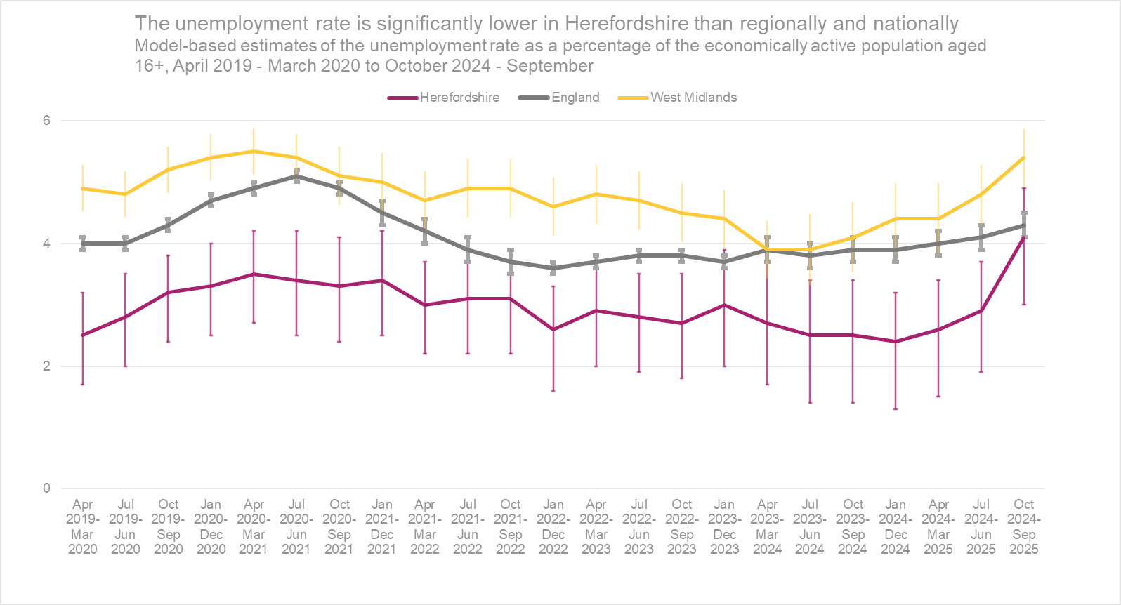
Model-based estimates of unemployment
Key points
Research published in the journal Socio-Economic Review has found that in the first year after job loss, UK families lose nearly a fifth (17%) of their income, compared with just 5-6% in Denmark, Finland or Germany and that although most Britons find new work within a year, they typically return to jobs paying 40% less than before, nearly double the income drop seen elsewhere. Similarly, research by the IFS has found that the risk of a worker falling into unemployment represents ‘one of the most important threats to the stability of households’ finances’, with workers who lose their job and receive unemployment benefits see their spending decline by around 20% in the first few months following job loss. On average, only a third of lost earnings is made up for by higher benefits.
ONS reports that the UK unemployment rate for people aged 16 years and over was estimated at 5.2% in October to December 2025, up in the latest quarter and above estimates of a year ago..
The model-based estimate of unemployment is ONS’s recommended measure of unemployment at local authority level. In the period October 2024 to September 2025 the unemployment rate as a proportion of economically active adults aged 16+ in Herefordshire was 4.1% (CI+-1.3), equating to c.4,100 people (+-1,300) lower than the 4.3% (CI+-0.2) in England as a whole and 5.4% (CI+-0.6) in the West Midlands region.
Compared to the previous period (June 2024 to July 2025), the Herefordshire rate was higher (4.1% vs 2.9%), a bigger increase than seen nationally and regionally.
Need to know
This dataset gives the official unemployment figures for local authorities. Percentages are of the economically active population aged 16 and over. Model-based estimates are produced for local authority areas. Estimates of unemployment for nations and regions are not model-based and have been taken directly from the Annual Population Survey dataset. No further breakdown is available below the all-age county rate. More information can be found in the User Guide. Estimates are modelled to improve their precision compared to those based only on responses provided via the Annual Population Survey. These estimates are calculated from a model based on the Annual Population Survey with Jobseeker's Allowance as an auxiliary. The disadvantage is that because it is based partly on a sample survey, the confidence intervals are still quite wide making it difficult to observe any statistically significant variation.For more information on the difference between the unemployment and claimant count rates see this article.
Data source: ONS -NOMIS
Date last updated: 20 January 2026
Frequency: Quarterly
Next update: April 2026

Slide 31
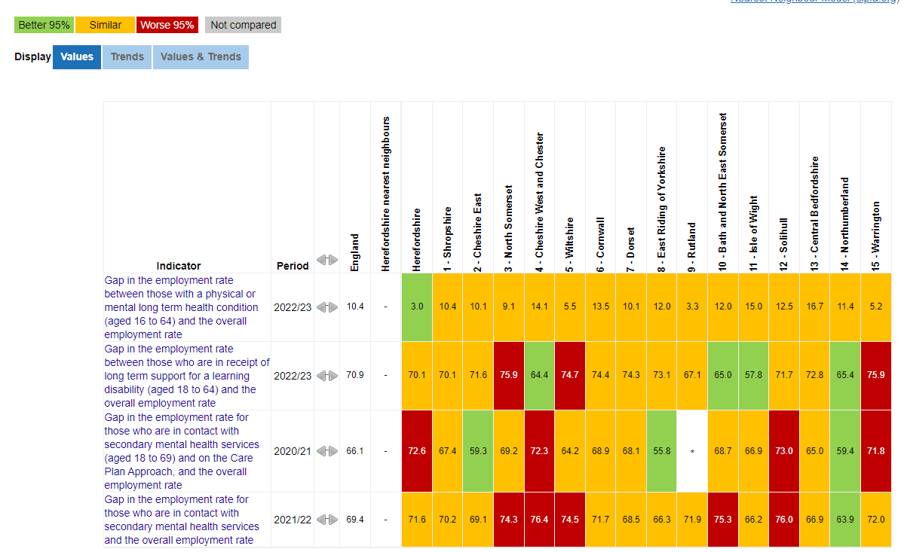
Employment gaps (compared to CIPFA* nearest neighbours)
*For more information on CIPFA statistical comparators see https://www.cipfa.org/services/cipfastats/nearest-neighbour-model
Source: Department of Health & Social Care – Fingertips Public Health Profiles
image copyright: https://fingertips.phe.org.uk © Crown copyright [2023].

Slide 32
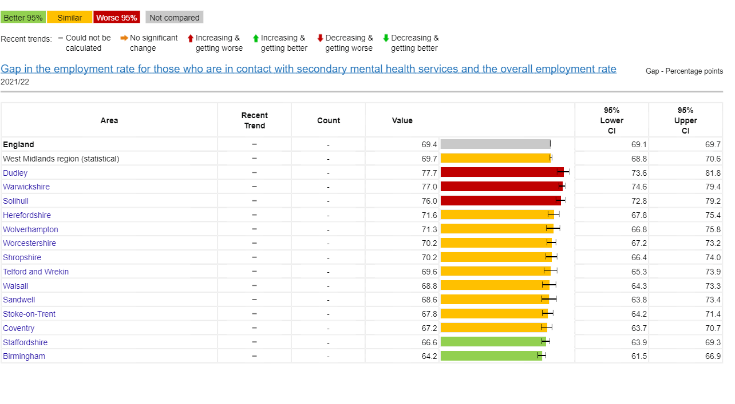
Unemployment and mental wellbeing
Key points
The relationship between mental health and unemployment complex and bi-directional. Good mental health is a key influence on employability, finding a job and remaining in that job. Unemployment causes stress, which ultimately has long-term physiological health effects and can have negative consequences for people’s mental health, including depression, anxiety and lower self-esteem. (Wilson & Finch, 2021). Those in unemployment tend to have lower levels of wellbeing than those in employment and conversely those with greater job security tend to have higher levels of wellbeing (Department of Health, 2014). Research conducted in 2022, in the wake of the covid-19 pandemic, found that mental health disabled workers were concentrated in those jobs and sectors that were most affected by the pandemic and associated response, pointing to the importance of segmentation and segregation as explanations of labour market inequality (Bryan et al, 2022).
In 2021/22, the gap in the employment rate between those in contact with secondary mental health services and the overall employment rate in Herefordshire was 71.6%, similar to England (69.4%) and the West Midlands (69.7%).
Data source: Department of Health & Social Care – Fingertips Public Health Outcomes Framewoek
Last updated: 3 May 2023
Frequency: Annual
Next update: t.b.c.
Image copyright: https://fingertips.phe.org.uk © Crown copyright [2024]
Need to know: Indicator definition - This indicator identifies the gap of employment rate between population who are in contact with secondary mental health services, and the employment of working population. It is based on an associated indicator from the Adult Social Care Outcomes Framework (ASCOF) and as such relates to a subgroup of people who have been in contact with mental health services rather than all people with mental health conditions.
The relationship between mental health and unemployment is bi-directional. Good mental health is a key influence on employability, finding a job, and remaining in that job. Unemployment causes stress, which ultimately has long term physiological health effects and can have a negative impact on mental health, including depression, anxiety, and lower self-esteem.

Slide 33
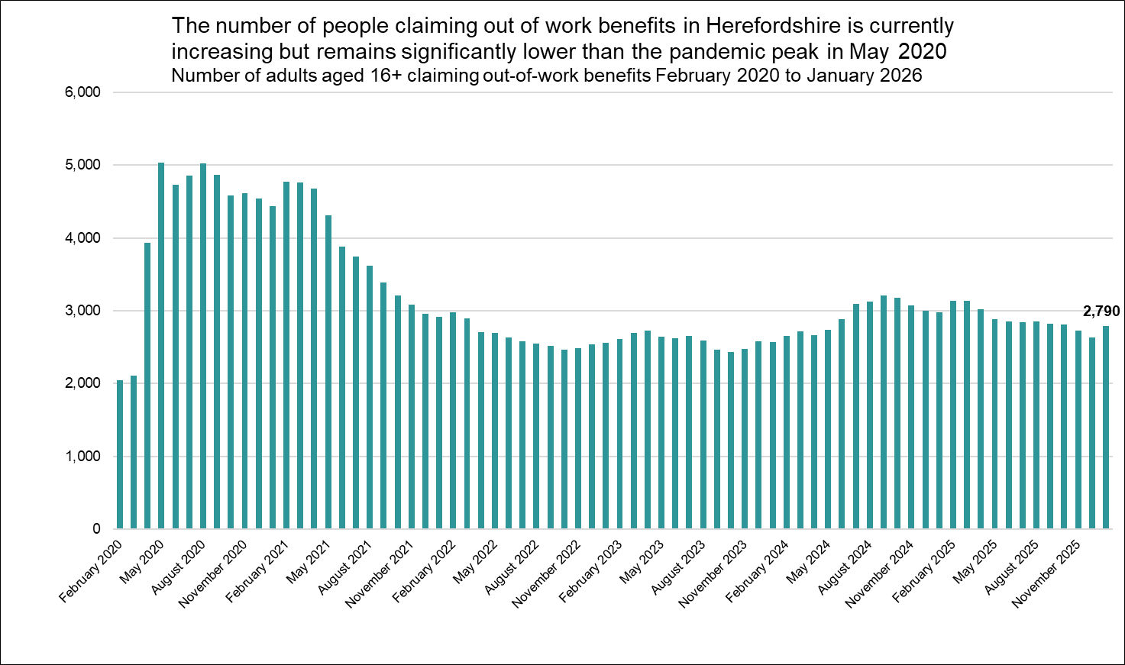
Out-of-work related claimant count: all ages
Key points
There were 2,790 people aged 16+ in Herefordshire claiming out-of-work-related benefits* in January 2026, up from 2,635 in December 2025 (revised) but well below the pandemic peak of 5,035 in May 2020.
Numbers remain significantly higher than pre-pandemic levels, being 36% higher than in February 2020 but this was a lower increase than in England as a whole (39%).
Numbers are currently higher than the peak in aftermath of the 2008 Financial Crisis (3,125 in February 2012).
The claimant count rate as a proportion of residents aged 16-64** was 2.6% in January 2026, compared to 4.9% for England and 5.2% for the West Midlands region.***
Need to know
*The Claimant Count is an experimental statistic that measures the number of people who are claiming unemployment-related benefits. It does not meet the internationally agreed definition of unemployment specified by the International Labour Organisation (ILO). Claimant Count includes people claiming Jobseeker's Allowance plus those claiming Universal Credit who are required to seek and be available for work. However, not everyone who is unemployed claims these benefits and ONS advises that ‘the Claimant Count does not attempt to measure unemployment. However, since the people claiming benefits are generally a particular subset of the unemployed, the Claimant Count can provide a useful indication of how unemployment is likely to vary between areas and over time. The model-based estimates of unemployment, which are derived from the ONS Annual Population/Labour Force Survey are the official measure of unemployment. For more information on this topic see the Economics Help website.
** IMPORTANT: Note this rate is not comparable to the official UK unemployment rate which is expressed as a proportion of the economically active population aged 16+.
***Note: In March 2025, ONS advised that the local authority, regional and national population estimates, used to calculate rates, had been updated to use the latest estimates compatible with the 2021 Census. These include the most recent 2023 estimates and the rebased series from 2011 to 2022.
Data source: ONS - NOMIS Date last updated: 17 February 2026
Frequency of update: Monthly
Next update: 19 March 2026

Slide 34
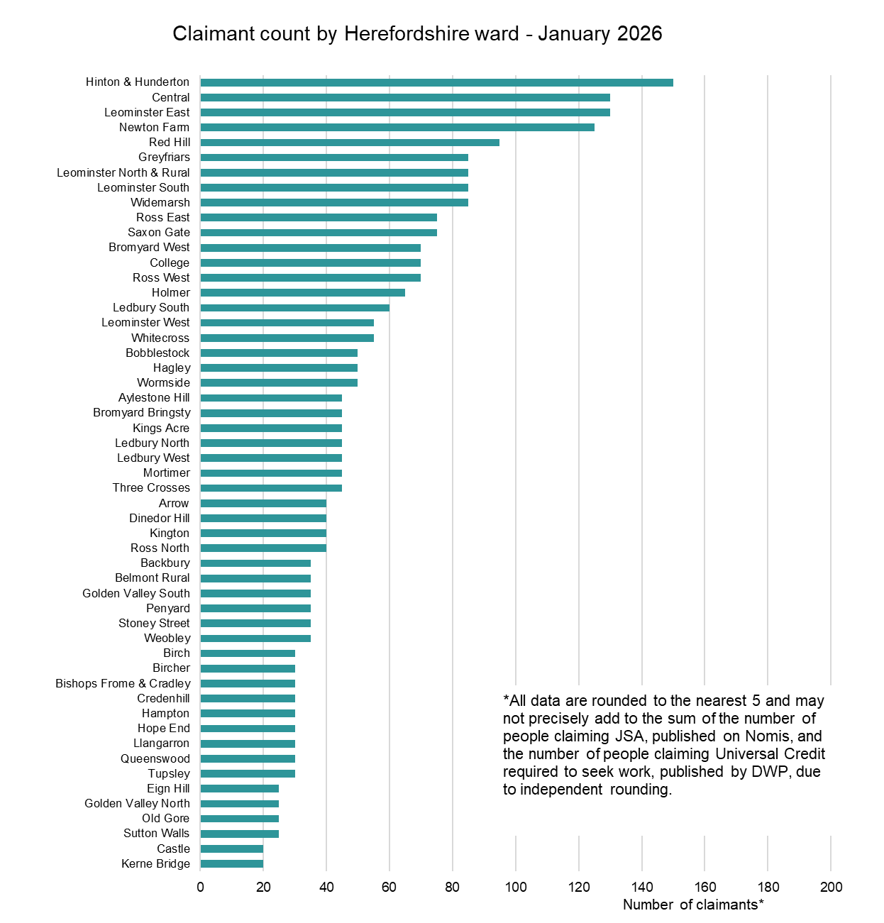
Out-of-work claimant count by ward
Key points
Generally, those wards with the highest numbers of claimants before the COVID-19 pandemic still have the highest numbers now.
In January 2026, the wards with the highest numbers of claimants were Hinton & Hunderton (150), Central (130), Leominster East (130), and Newton Farm (125).
The largest proportional increases in the claimant count since before the pandemic (February 2020) have occurred in Ledbury South (+140%), Mortimer (+125%) and Three Crosses (+125%).
In terms of numerical increases, the largest have been in Central (+65), Leominster North & Rural (+40) and Leominster East (+40).
Data source: ONS - NOMIS Date last updated: 17 February 2026
Frequency of update: Monthly
Next update: 19 March 2026

Slide 35
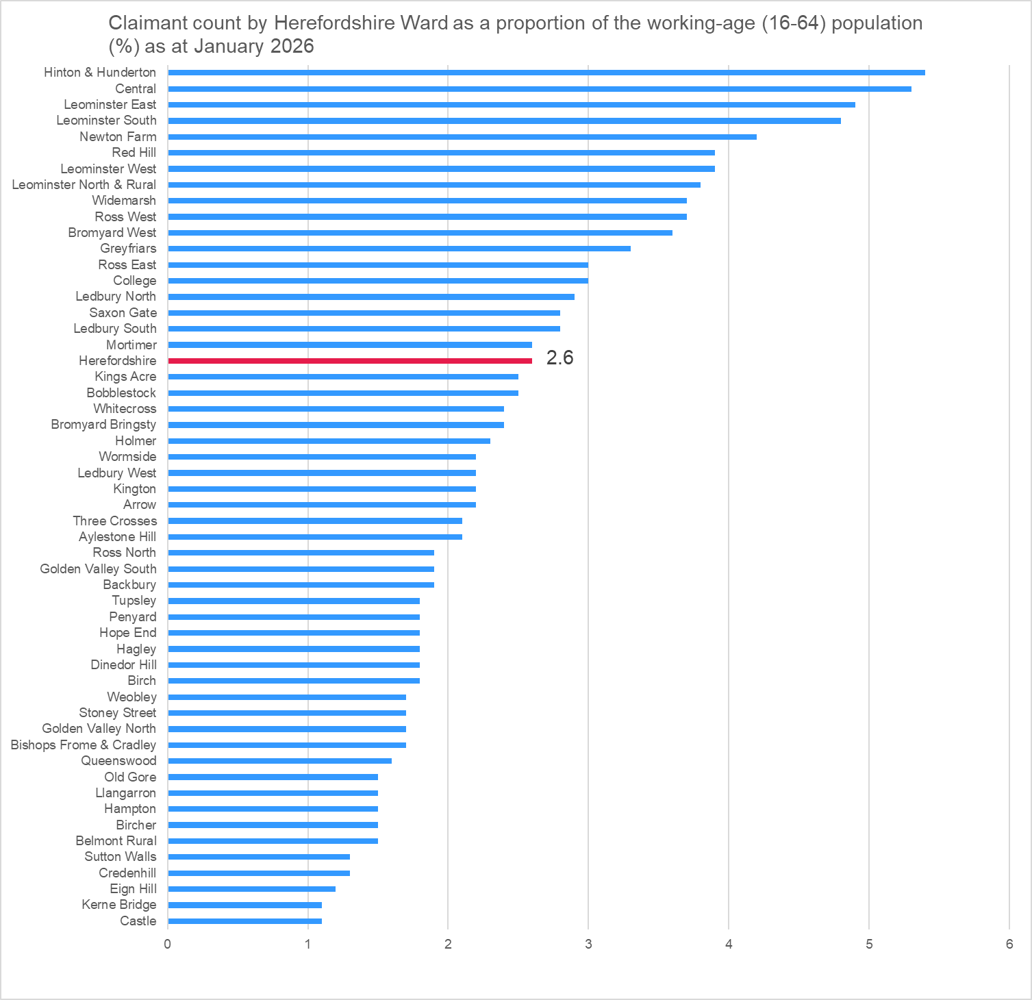
Out of work claimant count rate by ward
Key points
As the size of the working-age population (aged 16-64), who are eligible to claim out of work benefits, varies significantly between wards, it is useful to express the count as a rate, that is as a proportion of the working-age population.
However, it should be noted that due to the size of the population at ward level, relatively small changes in the numbers of claimants can have a significant impact on the rate.
As of January 2026, the wards with the highest claimant count rates were Hinton & Hunderton (5.4%), Central (5.3%), Leominster East (4.9%), and Leominster South (4.8%).
The lowest rates were in Castle (1.1%), Kerne Bridge (1.1%) and Eign Hill (1.2%).
The rate for Herefordshire as a whole was 2.6%.
Data source: ONS - NOMIS Date last updated: 17 February 2026
Frequency of update: Monthly
Next update: 19 March 2026

Slide 36
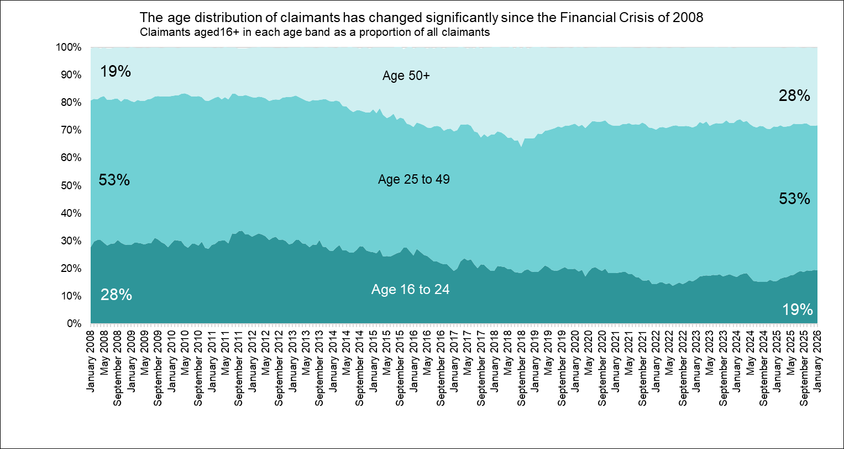
Age distribution of out-of-work claimants
Key points
Nationally, it has been reported that in the period November 2022 to January 2023, 3.5 million people aged 50 to 64 were out of work and not looking for work, compared to 3.3 million people of that age in January to March 2020: a rise of 280,000 people. The inactivity rate for those aged 50 to 64 rose by 1.7 percentage points, from 25.5% at the start of the pandemic to 27.2% in November to January 2023. This rise came after years of falling economic inactivity among this age group before the pandemic. Ill-health and/or early retirement have been identified as the primary drivers for the increase.
However, barriers to accessing employment may also be a factor and this is supported by the changing age profile of those who are out of work and claiming out-of-work benefits (the eligibility criteria for which include an expectation to be looking for work).
IFS research suggests that nationally many older workers were forced out of employment (through the jobs they were in not being compatible with home working and/or health fears) during the COVID-19 pandemic and that people who become inactive at older ages often never re-enter the workforce.
Looking at the age distribution of Herefordshire’s out-of-work benefit claimants now compared to January 2008 (before the Financial Crisis and the Great Recession) this has changed significantly.
In January 2008, 16 to 24-year-olds accounted for 28% of claimants and over 50s accounted for 19% of claimants in Herefordshire. In January 2026 16 to 24-year-olds accounted for 19% of claimants and over 50s 28% of claimants, completely reversing the distribution at the start of the period.
This change is partly a reflection of our ageing workforce but may also indicate that older workers who want to work are finding it harder to get another job than they did in the past. The Institute for Fiscal Studies has recently warned that increases in employers’ National Insurance contributions and the minimum wage for 18 to 20-year-olds changes may reduce job opportunities for young adults, which may have an impact on this trend.
Data source: ONS - NOMIS Date last updated: 17 February 2026
Frequency of update: Monthly
Next update: 19 March 2026

Slide 37
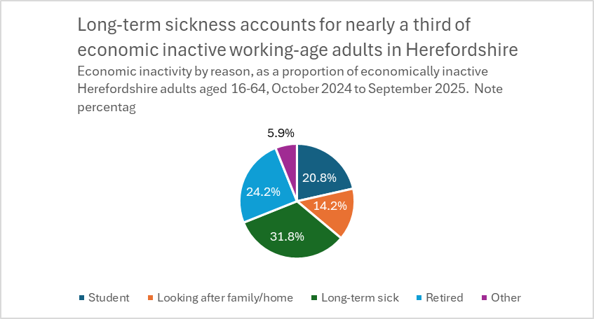
Long-term sickness
Economic inactivity as a result of long-term sickness can have a significant impact on the economy of a country and on welfare spending. For the individual, it can in itself have a detrimental impact on long-term health, as well as on financial security and social inclusion (NICE, 2019). An ageing workforce, increasing mental ill health, and obesity are all contributing to an increase in long-term sickness. (SOM) According to ONS, in Q1 2023, nationally the number of people economically inactive because of long-term sickness had risen to over 2.5 million people, an increase of over 400,000 since the start of the coronavirus (COVID-19) pandemic. Nearly two-fifths (38%) report having five or more health conditions (up from 34% in 2019), suggesting that many have interlinked and complex health issues. Internationally, the UK is the only G7 country with fewer people in work now than before the pandemic (PWC). In June 2023, research by the Resolution Foundation found that nationally economic inactivity due to ill health among 18 to 24-year-olds had nearly doubled over the past decade and was heavily concentrated among those with low levels of skills, with four-in-five young people who are too ill to work having only qualifications at GCSE-level or below. Young people in areas dominated by small towns and villages more likely to be workless due to ill health than those living in large cities. People with disabilities, in insecure employment, and in lower socio-economic groups, who are already at higher risk of financial insecurity and poverty, are also more likely to experience long-term sickness absence (IPPR, 2017).
Key points
2021 Census data show that 3.6% of usual residents of Herefordshire aged 16 years and over were economically inactive as a result of being long-term sick or disabled, up from 3.2% in 2011.
In February 2026, ONS reported that the UK economic inactivity rate for people aged 16 to 64 years was estimated at 20.8% in October to December 2025, down in the latest quarter and below estimates of a year ago.
According to the ONS Annual Population Survey, in the period October 2024 to September 2025 in the region of 6,000 people aged 16-64 in Herefordshire were economically inactive due to long-term sickness. However, as these data are based on a national survey the confidence intervals are very wide. These data show that long-term sickness rates as a proportion of those economically inactive in Herefordshire have fluctuated very significantly in the past two decades but are currently higher than for Great Britain and the West Midlands but not significantly so (31.8% in Herefordshire vs 28.8% in the West Midlands and 27.8% in Great Britain).
Data source: ONS - NOMIS
Frequency: Quarterly
Last updated: 20 January 2026
Next update: April 2026
Need to know:
Long-term sickness is defined by the DWP as ‘an instance of sickness absence from work lasting 4 or more weeks.’
Economic activity is defined by ONS as ‘people not in employment who have not been seeking work within the last four weeks and/or are unable to start work within the next two weeks.’
Note the wide confidence intervals associated with the Annual Population Survey at local authority level in the chart above.
Note chart percentages do not total 100% as percentages for temporary sick and discouraged could not be calculated. Due to survey sample size

Slide 38
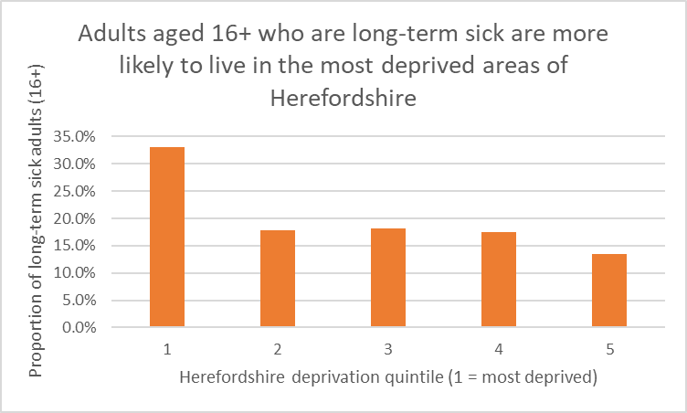
Long-term sickness by Herefordshire deprivation quintile
Key points
According to The Health Foundation more working-age people in the UK are living with long-term health conditions than ever before. For many, poor health means not being able to work. The relationship between long-term sickness and deprivation is complex, involving not only inequalities in economic and social capital, but cultural and lifestyle factors, and the differing types of work more likely to be undertaken by different socio-economic groups.
The King’s Fund has found that people in the poorest social class have a 60% cent higher prevalence of long-term health conditions than those in the richest social class.
2021 Census data indicated that there were around 5,600 adults aged 16+ in Herefordshire who were economically inactive as a result of being long-term sick.
A third of these people were from the most deprived quintile of the county, compared to 13% from the least deprived.
Herefordshire deprivation quintile (1 = most deprived) | Count of adults aged 16+ who are long-term sick | Proportion of adults aged 16+ who are long-term sick
1 | 1,855 | 33%
2 | 1,003 | 18%
3 | 1,021 | 18%
4 | 977 | 17%
5 | 756 | 13%
Total | 5,612 | 100%
Need to know: The 2021 Census took place at the time of significant disruption to the labour market as a result of the covid-19 pandemic. ONS advises ‘as Census 2021 was during a unique period of rapid change, take care when using this data for planning purposes.’ For this reason, it is inappropriate to compare these data to 2011 Census data.
Data source: ONS
Frequency: Decennially
Last updated: 8 December 2022
Next update: 2031

Slide 39
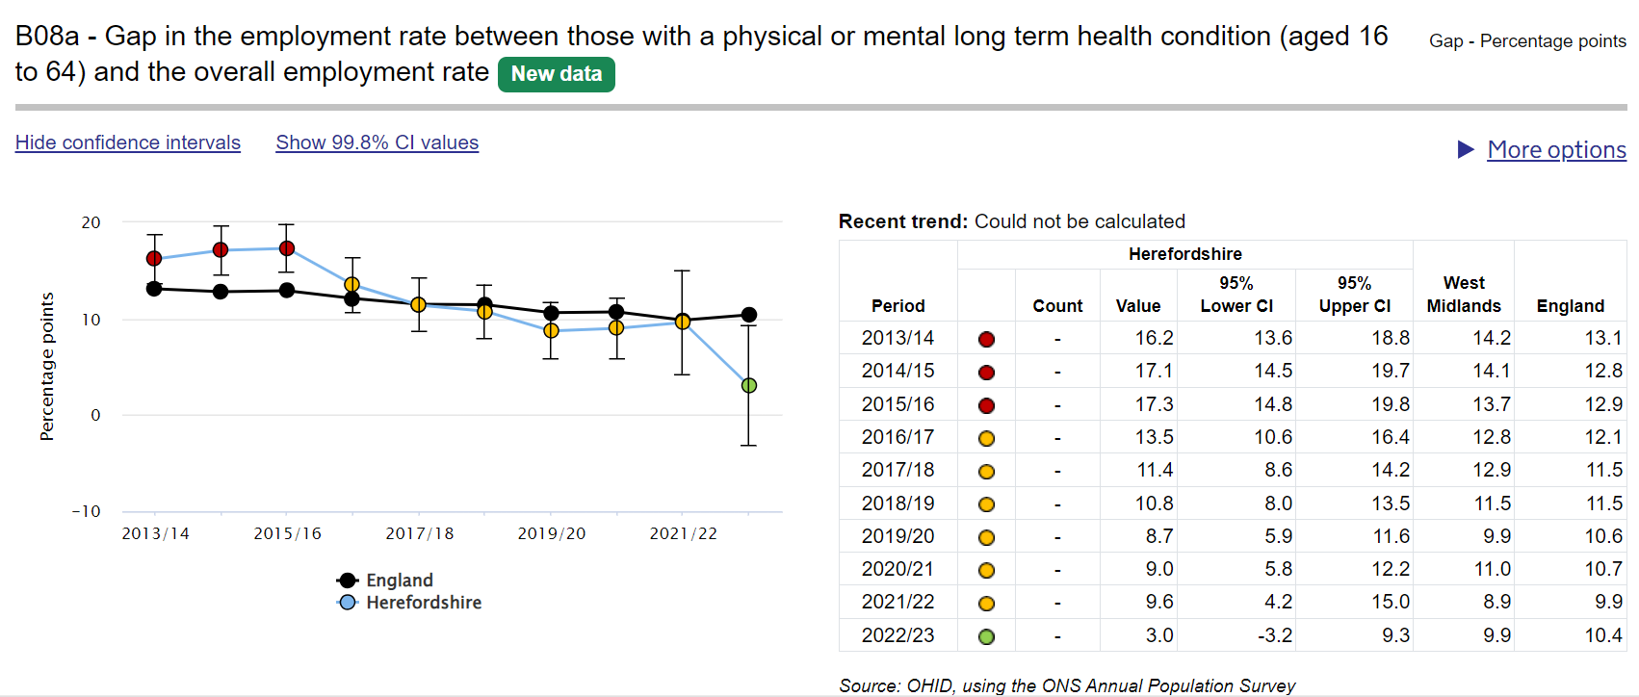
Long-term conditions and employment
Key points:
Data from ONS’s Annual Population Survey suggest that in 2022-23 72.9% (CI 65.4% - 80.3%) of working-age people (16-64) with a physical or mental long term health condition in Herefordshire were in employment, higher than in England (65.3% CI 64.6% - 66.0%) and the West Midlands ((63.7% CI 61.6% - 65.8%) but not significantly so. In 2022-23, Herefordshire had the 2nd highest employment rate out of 14 comparable West Midlands local authority areas.
In Herefordshire, in 2022-23, the gap in the employment rate between those with a physical or mental long-term health condition (aged 16 to 64) and the overall employment rate was 3.0% (CI -3.2% to 9.3%); lower than in England (10.4% CI 8.4% - 12.4%) and the West Midlands (9.9% CI 7.3% - 12.6%) but due to the large confidence intervals, not significantly so.
Contrary to upward movement in the West Midlands and England, the Herefordshire rate fell in 2022-23 from 9.6% (CI 4.2% - 15.0%) in 2021-22. The reasons for this are unclear and due to the wide confidence intervals around these data, the fall was not statistically significant.
Research by IFS published in April 2024 found that 4.2 million working-age individuals (10.2% of the working-age population) were receiving at least one health-related benefit. This was up from 3.2 million in 2019 (7.9%), driven by rapid increases in the number of people starting a new benefit claim. Prior to the pandemic, both incapacity and disability benefits saw about 20,000 new claims each month. By November 2022, there were 51,000 new claims for incapacity benefits and 43,000 new claims for disability benefits each month.
Source: Department of Health & Social Care – Fingertips Public Health Outcomes Framework
Last updated: 7 November 2023
Frequency: Annual
Next update: t.b.c.
image copyright: https://fingertips.phe.org.uk © Crown copyright [2023].
Need to know: Indicator definition- the percentage point gap between the percentage of respondents in the Labour Force Survey who have a long-term condition who are classified as employed (aged 16 to 64) and the percentage of all respondents in the Labour Force Survey classed as employed (aged 16 to 64) .
A long-term condition is defined as a physical or mental health condition or illness lasting or expected to last more than a year.

Slide 40
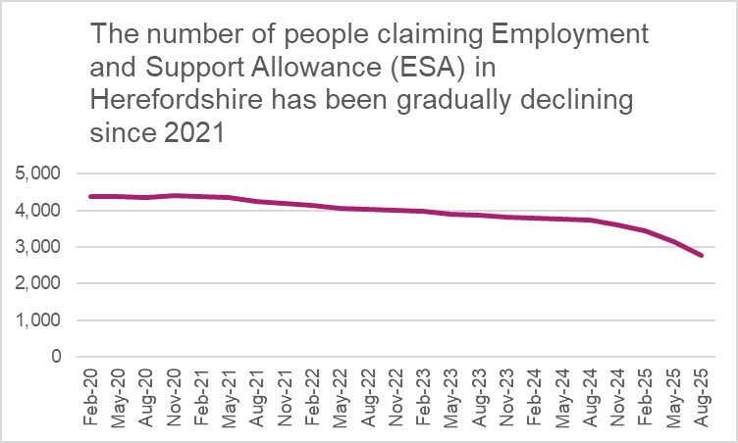
Employment and Support Allowance (ESA) claimants
In March 2025, the Department for Work and Pensions reported that 2.8 million people in the UK were economically inactive due to long term sickness – one of the highest rates in the G7.
Employment and Support Allowance (ESA) can be claimed by adults under state pension age who have a disability or health condition that affects how much they can work. ESA replaced Incapacity Benefit and Severe Disablement Allowance for new claimants from October 2008.
ESA provides:
Money to help with living costs for those unable to work.
Support to get back into work for those able to do so.
People can apply if they are employed, self-employed or unemployed. How much they get depends on what stage their application is at, as well other criteria such as age and whether they are able to get back into work. Claimants can get new style or contribution-based ESA on its own or at the same time as Universal Credit. If they get both at the same time, the ESA payment is deducted from the Universal Credit payment. Income-related ESA has also been replaced by Universal Credit.
Key points
Since 2021, the number of ESA claimants in Herefordshire has been on a gradual but consistent downward trajectory, falling from 4,403 in November 2020 to 2,766 (provisional) in August 2025. In addition, a small number of claimants (64 in August 2025) whose claims were made prior to October 2008 are still in receipt of Incapacity Benefit and Severe Disablement Allowance.
Data source: Department for Work & Pensions (Stat-Xplore)
Frequency: Quarterly in arrears
Last updated: 18 February 2025
Next update: May 2026

Slide 41
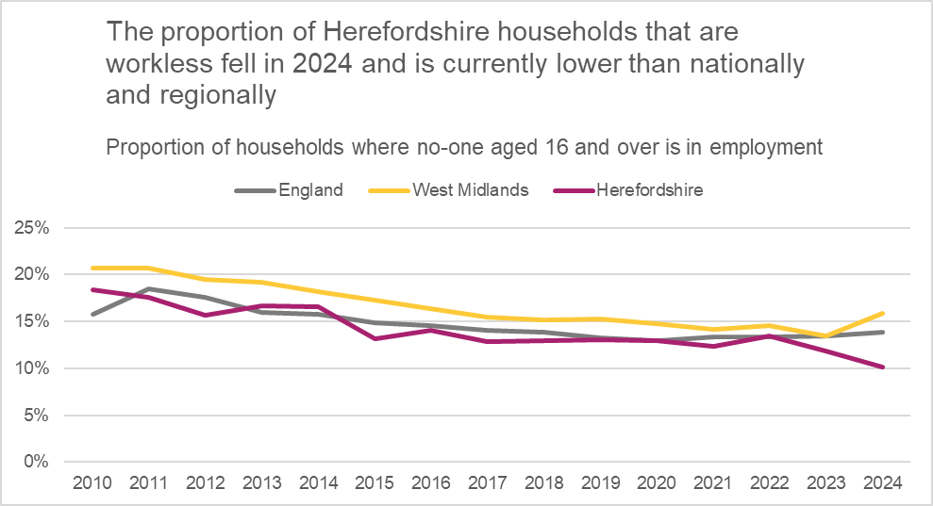
Workless households
Some forms of worklessness are associated with a range of adverse social and health outcomes, with long-term negative impacts for the wellbeing and life chances of affected households.
Even before the current cost-of-living crisis, Department for Work & Pensions (DWP) analysis (2017) found that that problem debt was around twice as prevalent in workless households. Around 60% of housing benefit claimants in temporary accommodation are workless or on out-of-work benefits. In couple-parent families, relationship distress is around three times as prevalent if both parents are workless, as when both parents are working. The vast majority of parents reporting treatment for drug/alcohol use/dependency had been out of work for at least a month. Around half of children in workless families are living with parents who have at least three potential barriers to work, such as ill health, low qualifications or lone parenthood. Children in workless families are almost twice as likely to live with at least one parent with poor mental health. Children growing up in workless families are almost twice as likely as children in working families to fail to reach the expected levels at all stages of their education and are more likely to more likely to suffer mental and physical ill-health in later life if they have jobless parents during their childhood.
Key points
In 2024 (the latest data available), the estimated proportion of workless households in Herefordshire (10.1%) had fallen slightly from 11.8% in 2023 and was lower than in England (13.9%) and the West Midlands (15.9%).
2021 Census data indicated that around 9,700 usual residents aged 16 and over in Herefordshire (6%) had never worked or were long-term unemployed and therefore classified as ‘workless’. This was higher than in 2011 (4%), but was lower than nationally (9% in 2021, up from 6% in 2011).
Data source: ONS
Last updated: 30 July 2025
Frequency: Annually
Next update: 29 July 2026
Need to know: Workless households are households where no one aged 16 years or over is in employment. These members may be unemployed or economically inactive. Economically inactive members may be unavailable to work because of family commitments, retirement or study, or sickness or disability. Percentages are of working age households i.e. where at least one household member is aged 16-64. ONS advises that the population totals used for the latest LFS estimates use projected growth rates from Real-Time Information (RTI) data for EU and non-EU populations based on 2021 patterns. The total population used for the LFS therefore does not take into account any changes in migration, birth rates, death rates, and so on, since June 2021, so levels estimates may be under- or over-estimating the true values and should be used with caution.

Slide 42
Section 3: Household finances

Slide 43
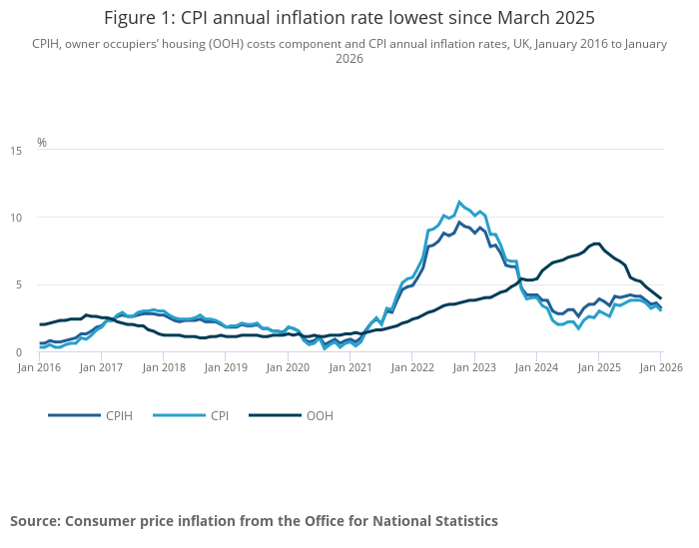
Inflation
Key points
ONS reports that the Consumer Prices Index including owner occupiers' housing costs (CPIH) rose by rose by 3.2% in the 12 months to January 2026, down from 3.6% in the 12 months to December 2025. On a monthly basis, CPIH fell by 0.3% in January 2026, while it was little changed in January 2025.
The Consumer Prices Index (CPI) rose by 3.0% in the 12 months to January 2026, down from 3.4% in the 12 months to December 2025. On a monthly basis, CPI fell by 0.5% in January 2026, compared with a fall of 0.1% in January 2025..
Transport, and food and non-alcoholic beverages made the largest downward contributions to the monthly change in both CPIH and CPI annual rates.
Core CPIH (excluding energy, food, alcohol and tobacco) rose by 3.3% in the 12 months to January 2026, down from 3.5% in the 12 months to December 2025; the CPIH goods annual rate fell from 2.2% to 1.6%, while the CPIH services annual rate fell from 4.5% to 4.3%.
Core CPI (excluding energy, food, alcohol and tobacco) rose by 3.1% in the 12 months to January 2026, down from 3.2% in the 12 months to December 2025; the CPI goods annual rate fell from 2.2% to 1.6%, while the CPI services annual rate fell from 4.5% to 4.4%.
Need to know: The Consumer Prices Index including owner occupiers' housing costs (CPIH) is the lead and most comprehensive measure of consumer price inflation CPIH includes a measure of the costs associated with owning, maintaining and living in one's own home, known as owner occupiers' housing costs (OOH), along with Council Tax. Both are significant expenses for many households and are not included in the CPI. However, the Consumer Prices Index (CPI) is based on a harmonised methodology developed by Eurostat and allows for international comparisons to be drawn.
Source: ONS
Last updated: 18 February 2026
Frequency of update: Monthly
Next update: 23 March 2026

Slide 44
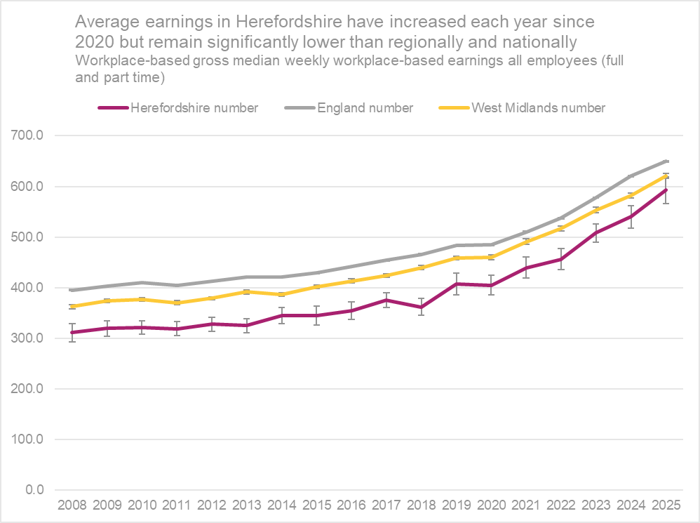
Earnings
Key points
ONS reports that early estimates for January 2026 indicate that median monthly pay was £2,588, an increase of 4.6% compared with the same period of the previous year. Throughout 2022, the growth rate of median pay continued to increase in line with pre-pandemic trends, but with increasing volatility in late 2022 and into 2023. This pace of growth slowed in late 2023 and remained close to 6% throughout 2024 and 2025. A series of lower-than-average median pay growth figures were observed in late 2025, likely influenced by the timing of public sector pay settlements having differed from the previous year.
The IFS has reported that the UK went from one of the fastest growers for working-age incomes among developed countries pre-2007, to one of the slower performers. While growth slowed across the board, the UK’s growth from 2007 to 2019 (6%) was well below that of the US (12%) and Germany (16%). IFS research has also pointed to widening geographical inequalities in earnings across the country.
Workplace-based median weekly earnings for all employees (full and part-time) who work in Herefordshire in 2025* were £592.6 +/-£26.7: a 9.8% increase from the amount recorded for 2024 (£539.8) and a larger percentage increase than in the West Midlands (6.6%) and England (4.8%). Herefordshire earnings remain significantly lower than the average for England (£649.8 +/-£1.3) and the West Midlands (£620.9 +/- £5.0).
In 2025, the largest gap between Herefordshire and the England average was amongst full-time male workers (£100.1). The gap was smallest for male part--time workers (£13.8).
In 2025, Herefordshire ranked 9th of the 14 comparator West Midlands authorities.
Data source: ONS – NOMIS (Annual Survey of Hours and Earnings (ASHE)
Frequency: Annually
Last updated: 12 November 2024
Next update: November 2026
Need to know: Workplace-based earnings includes all people who work in Herefordshire regardless of which county they live in.. This gives a better sense of earnings from local employment than the residence-based measure.
Earnings figures are for full and part-time employees – Herefordshire has a higher proportion of part-time employees than both England and the West Midlands region.
*2024 data are provisional.

Slide 45
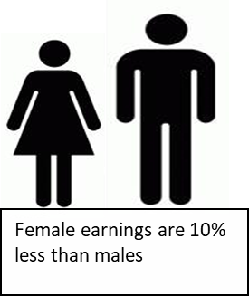
Gender pay gap
Key points
The gender pay gap is a persistent source of inequality. According to ONS, in the UK the gender pay gap has been decreasing slowly over time; over the last decade it has fallen by more than a quarter among full-time employees, and in April 2025, it stood at 6.9%, down from 7.1% in April 2024. However, men in full-time employment earned more than women in full-time employment in all major occupation groups in April 2025. The gender pay gap is larger for employees aged 40 years and over than for those aged under 40 years. The gender pay gap is larger among high-paid employees than among lower-paid employees, and women employees’ share in high-paying occupations decreases with age..
The gender pay gap is higher for all employees than it is for full-time employees or part-time employees. This is because women fill more part-time jobs, which in comparison with full-time jobs have lower hourly median pay.
In 2021, research by IFS found that over three-quarters of the reduction in the earnings gap over the past 25 years can be explained by the rapid increase in women’s educational attainment. It also found that the divergence in earnings occurs with parenthood, when the gendered roles that mothers and fathers take on appear to be largely unrelated to their relative earnings potential. IFS suggests that persistent social norms around parenting are reinforced by a policy environment that sustains and incentivises a traditionally gendered division of labour, even when policies are ostensibly gender-neutral.
Provisional data suggest that in Herefordshire in 2025, the median gender pay gap for all employees was 10.2% slightly up from 9.8% in 2024, but still smaller than in both the West Midlands region (15.3%) and England (13.5%). For full-time employees only, the gap in Herefordshire was 9.8% compared to the West Midlands (10.1%) and England (7.7%).
In 2024*, the median gender pay gap (all employees) in Herefordshire was 9.9% but for full-time workers it was 0.1%
*provisional data
Source: ONS – Annual Survey of Hours and Earnings (ASHE)
Frequency: Annually
Last updated: 14 November 2025
Next update: November 2026
Need to know:
Source table = PROV - Work Geography Table 7.12 Gender pay gap 2023.xls
Herefordshire has a higher proportion of part-time employees than both England and the West Midlands region. Figures for part-time earnings only are not available for Herefordshire.
* ONS advise that over the coronavirus (COVID-19) pandemic period, earnings estimates were affected by changes in composition of the workforce and the impact of the Coronavirus Job Retention Scheme (furlough) making interpretation difficult; also data collection disruption and lower response rates mean that, for 2020 and 2021, data were subject to more uncertainty and should be treated with caution; so users are being encouraged to focus on long-term trends rather than year-on-year changes.

Slide 46
Income from self-employment
Key points
In the period October 2024 to September 2025, there were estimated to be around 18,500 people aged 16+ in Herefordshire who were self-employed (ONS - NOMIS)
The proportion of the working-age population (16-64) in Herefordshire who were self-employed (12.4%) was higher than in both Great Britain as a whole (9.5%) and the West Midlands region (8.1%) (ONS - NOMIS).
2021 Census data showed the rate of self-employment in Herefordshire to be 12% of adults aged 16+, which meant Herefordshire sat just outside the highest 10% of local authorities across England and Wales (the national rate was 10%). The rate remained relatively stable since 2011, both locally and nationally.
In the tax year 2022-23, median income from self-employment in Herefordshire was £15,700; slightly higher than for the West Midlands region as a whole (£16,100). Median income was sixth highest of the 14 upper-tier West Midlands local authorities but due to the small sample sizes involved any apparent differences should be treated with caution (see note below).
West Midlands Unitary, County, or Metropolitan Borough area | Self-employment income 2021-22: Median (£)
Dudley | 17,700
Walsall | 17,000
Sandwell | 16,600
Wolverhampton | 16,500
Solihull | 16,300
Herefordshire UA | 15,700
Telford and Wrekin UA | 15,600
Staffordshire County | 15,500
Worcestershire County | 15,400
Coventry | 15,200
Shropshire UA | 15,200
Stoke-on-Trent UA | 15,100
Birmingham | 15,000
Warwickshire County | 14,800
Need to know: NOMIS estimates of the numbers and proportions of self-employed are taken from the Annual Population Survey (APS) and thus differ from the 2021 Census figures. Census data show the rate of self-employment in Herefordshire to be 12% of all 16+ year-olds – just outside the highest 10% of local authorities across England and Wales (the national rate was 10%). The number of self-employed (full and part-time including those who are also students) was 19,400 in 2021.
Self employment income is profit chargeable under the Income Tax (Trading and Other income) Act 2005 less losses brought forward and capital allowances allowed. Median income data are derived from the Survey of Personal Incomes (SPI). HMRC advises that due to the small sample sizes estimates of income for sub-UK geographical areas (e.g. by country, region, county etc.) should be treated with particular caution. Note: These data cannot be meaningfully compared to employees’ annual earnings.
Data source: HM Revenue & Customs - Income and tax by borough and district or unitary authority
Frequency: Annually
Last updated: 12 March 2025
Next update: March 2026

Slide 47
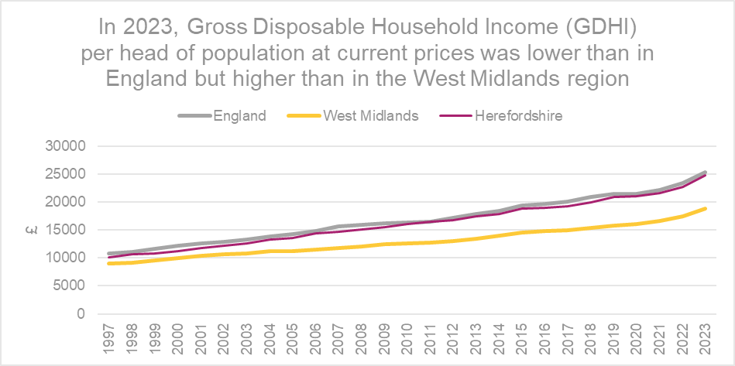
Gross disposable household income (GDHI)
Key points
ONS reports that GDHI in the England grew by 9.6% in 2023, London had the highest GDHI per head in 2023 where, on average, each person had £35,361 available to spend or save; the North-East had the lowest at £19,977, compared with a UK average of £24,836.
In 2023, Herefordshire’s GDHI per head at current prices was £24,774, lower than England £25,425 but higher than for the West Midlands (£18,900).
In 2023, GDHI per head of population in Herefordshire increased by 9.0% from 2022, more than England (8.5%) and the West Midlands region (8.4%).
The relatively high level of GDHI per head in Herefordshire compared to the West Midlands as a whole is in contrast to the low level of earnings for the county and the low Gross Value Added (GVA) per head. This difference may be partly explained by a relatively large proportion of people of retirement age in Herefordshire, who may derive a considerable income from pensions and other financial assets and investments.
Need to know: GDHI is the amount of money that individuals have available for spending or saving and is a concept that is seen to reflect the “material welfare” of the household sector, as such it is preferred to Gross Value Added (GVA) as the measure of economic welfare.
The household sector includes residents of traditional households, as well as those living in communal establishments. GDHI also includes the business income of self-employed people.
GDHI includes income from wages, salaries, self-employment, property and pensions and is money left after expenditure associated with this income i.e. taxes and social contributions. To make the measure comparable between areas, per head indices are used.
Data source: ONS
Date last updated: 10 September 2025
Frequency: Annually
Next update: t.b.c.

Slide 48
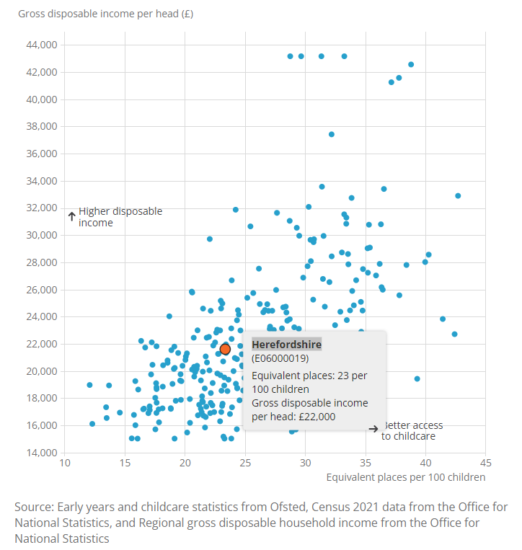
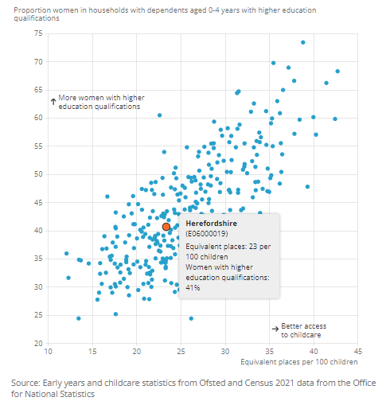
Access to childcare
Accessible childcare can be crucial for parents and guardians who want to return to work, increase their hours, or even enter the labour market for the first time. A primary challenge for families is whether they can access suitable childcare locally.
Key points
ONS reports that areas with lower levels of access to childcare were generally more likely to have lower disposable household incomes, on average, and a higher proportion of children living in poverty. In Herefordshire in 2023 there were an average of 23 childcare places per 100 children aged 0-7 years, compared to 25 across England as a whole and GDHI per head was £22,000.
There was a particularly strong relationship between childcare access and women's qualifications. Among women in households with dependent children aged 0 to 4 years, the proportion with higher education qualifications tended to be higher in areas with higher levels of childcare access. Of the 10 local authorities with the highest levels of childcare access, nine were also in the highest 10% for the proportion of women in households with dependent young children, who were highly qualified. The 10 local authorities with the lowest levels of childcare access were in the lowest 30% for proportions of women with dependent children, who were highly qualified. In Herefordshire in 2023 41% of women in households with dependent children aged 0 – 4 years had higher education qualifications.
By public transport, there was the equivalent of 13 childcare places accessible per 100 children aged 0 to 7 years in the West Midlands in 2023. That was the lowest of England’s nine regions.
Source: ONS
Date last updated: 4 June 2024
Frequency: Annually
Next updated: t.b.c.

Slide 49
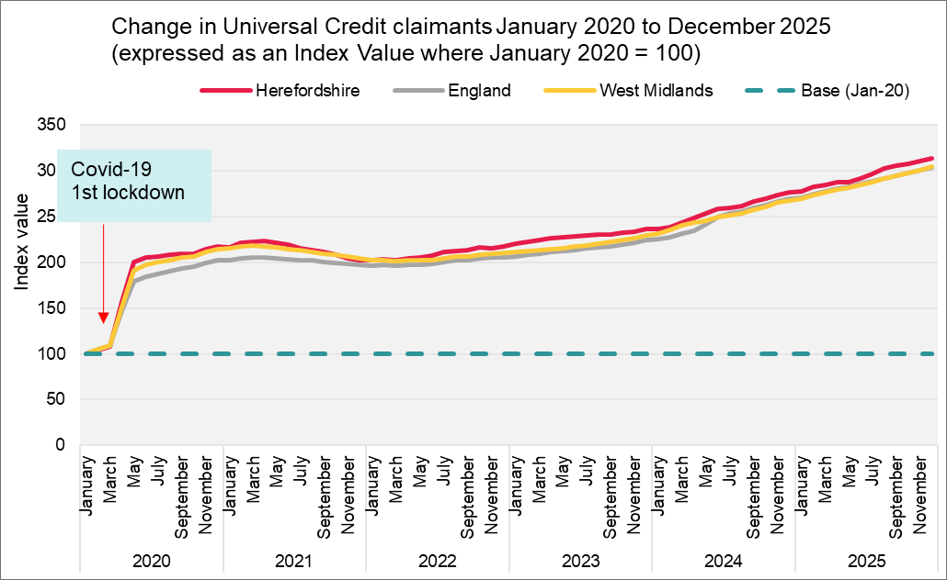
People claiming Universal Credit (UC)
Key points
The number of people claiming the Universal Credit (UC) doubled between March 2020 and May 2020, since when claimant numbers have remained at a high level and are currently on an upward trend. Provisional data suggest there were 17,404 Universal Credit in claimants in Herefordshire in December 2025, 2,204 more than a year ago and 5,011 more than the pandemic peak (April 2021).
The primary driver for the increase in UC claimants remains the ongoing migration of individuals from older "legacy" benefits into the UC system. Other contributing factors include rising numbers of people claiming benefits for mental health conditions, particularly among the working-age population, and potentially higher overall poverty levels due to increasing living costs and stagnating wages.
In Herefordshire, UC claimants currently comprise 16% of the working age population; lower than the West Midlands Region (23%) and England (20%).
The wards with the highest number of UC claimants were Hinton & Hunderton (971), Newton Farm (944, Leominster East (674), and Red Hill (617).
In August 2025, there were 14,028 households in Herefordshire on Universal Credit, 1,932 more than in August 2024. Of these households 6,758 (48%) contained at least one child.
Between 2022 and early 2024, people claiming Universal Credit were among those entitled to additional Cost of Living Payments (CoLPs), lump-sum payments intended to support immediate pressures faced by the most vulnerable households.
Need to know:
The monthly number of people on Universal Credit includes all individuals who have an open claim on the count date for the month.
Some people will have their claim terminated either at the request of the individual or if their entitlement to Universal Credit ends. If a termination is recorded, but the person is still receiving a payment, then the claim will still be classed as live at the end of each reporting month.
The latest month's figures are provisional and are subject to change in the next publication where they will be revised and finalised. Monthly figures are currently not subject to retrospection beyond the first revision.
Data source: Department for Work & Pensions (Stat-Xplore)
Last updated: January 2026
Frequency of update: Monthly
Next update: March 2026

Slide 50
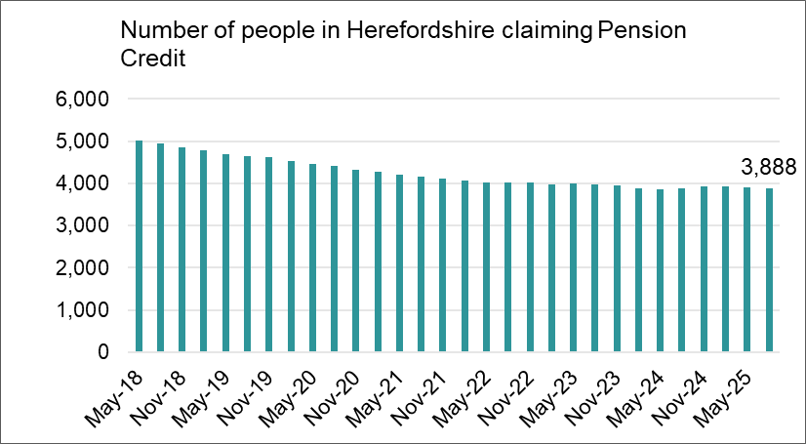
People claiming Pension Credit
In September 2025, the Living Wage Foundation reported that a low pension negatively affects older people’s health, wellbeing and quality of life. Over half (54%) of people on a low pension were struggling to cover their bills, with some groups, such as people renting their homes, people with health conditions, and people living alone struggling disproportionately. Many were also cutting discretionary spending, and report that their financial difficulties are negatively affecting their mental health, anxiety and sleep.
Key points
Pension Credit provides help with living costs for people who are over State Pension age and on a low income. Pension Credit can also help with housing costs such as ground rent or service charges.
The number of people claiming Pension Credit (PC) in Herefordshire has fallen from 5,025 in May 2018 from 5,025 to 3,888 in August 2026.
In August 2025, the wards with the highest number of pension credit claimants were Leominster East (179) Hinton & Hunderton (134), Kington (131) and Widemarsh (130).
Need to know: The age in which you qualify for pension credit has gradually increased from 60 to State Pension Age between April 2010 and November 2018 in line with the female State Pension age.
To be entitled to Pension Credit, you must be of qualifying age and living in Great Britain. In the case of a couple, either may claim if both are of qualifying age but only one partner can get Pension Credit at any one time. The second element is the savings credit whereby pensioners aged 65 and over receive a cash reward for their second pension or savings income above the level of the savings credit threshold.
Data source: Department for Work & Pensions (Stat-Xplore)
Frequency: Quarterly in arrears
Last updated: 12 November 2025
Next update: May 2026

Slide 51
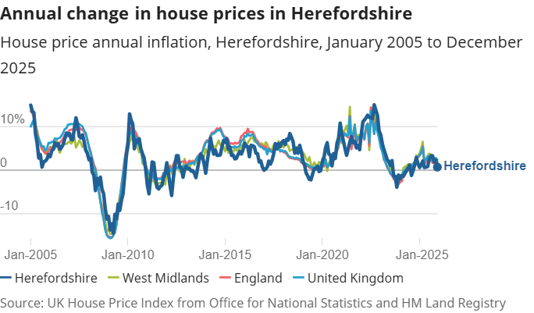
House prices
Key points
In the year ending March 2025, ONS data showed that the average (median) house prices for Herefordshire, England and the West Midlands region and England were £295,000, £300,000 and £250,000 respectively. The median price paid in Herefordshire was unchanged from the year to December 2024.
Looking at how housing prices in England have changed in the last month, HM Land Registry data on average in December 2025 house prices fell by 0.7% from November 2025. The annual price rise of 1.7% took the average property value to £292,000. In the West Midlands region, the average house price was £246,000, an annual change of +2.0% and -1.0% from the previous month.
According to ONS data, the average house price in Herefordshire was £287,000 in December 2025 (provisional), up 0.7% from December 2024. This was lower than the rise in the West Midlands (2.0%) over the same period.
For each property type, average prices as of December 2025 in Herefordshire were detached properties: £438,000, semi-detached properties: £279,000, terraced properties: £209,000, flats and maisonettes: £127,000. Since January 2005, the trend in house price inflation in Herefordshire has been broadly similar to nationally and regionally (see chart).
Source: ONS
Frequency: Monthly
Last update: 18 February 2026
Next update: 25 March 2026

Slide 52
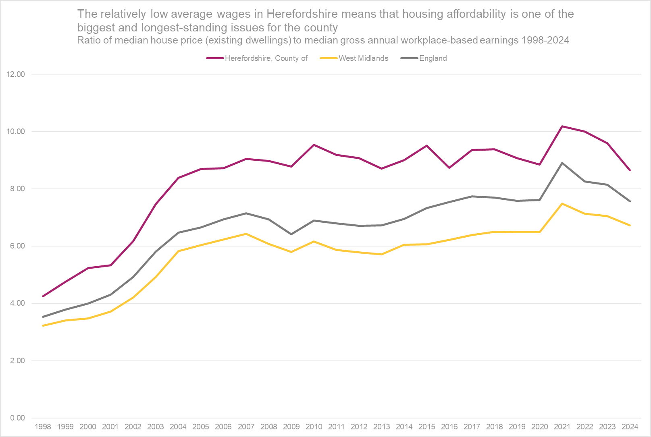
Housing affordability
There has been a long-term trend of worsening housing affordability nationally but with some areas worse affected than others. Housing affordability is linked to house prices and to wages and is indicative of high demand and/or inadequate supply in the housing market of an area. According to one estimate, 340,000 new homes need to be supplied in England each year, of which 145,000 should be affordable, in order to meet predicted demand.
ONS reports that housing affordability in England and Wales returned to its pre-pandemic levels in 2024 after a sharp increase between 2020 and 2021 (worsening affordability); median house sales prices have increased by 1% since 2021, while average earnings have increased by 20%.
Its rurality means that Herefordshire has an over-representation of desirable, larger detached houses combined with a relatively low wage economy, which creates barriers to home ownership for young and single people and for those with low to average earnings. At the same time, the county is an attractive destination for those from more affluent areas.
Key points
In 2024, the ratio of median house price to median annual workplace-based earnings in Herefordshire was 8.65, down from 9.59 in 2023 but still significantly higher than in England (7.57) and the West Midlands region (6.73).
ONS reports that in 2023, first-time buyer mortgages per 1,000 dwellings in Herefordshire fell to 6.5 from 10,1 in 2021 and was below the UK average of 9.6, which may also point toward a lack of affordable housing for first-time buyers.
Data source: ONS
Last updated: 24 March 2025
Frequency: Annually
Next update: March 2026
Need to know: Housing affordability can be measured based on either residence-based earnings or workplace-based earnings. The latter is, on balance, a more accurate reflection of the county’s economic status and as such is more influential in planning. The data above are for the lower quartile (rather than median ratio) as this gives a better representation of conditions at the lower end of the market where most first-time buyers are concentrated.
*The sharp price increases in 2021 corresponded with increases in the volume of sales and changes in Stamp Duty Land Tax and Land Transaction Tax. The ratios in 2022 are therefore a return to the long-term trend, following a sharp increase in 2021. In March 2024 ONS stated that they were no longer intending to publish lower quartile data hence we are now reporting the median house price. .

Slide 53
Private rental costs
Key points
Nationally, a chronic undersupply of private rental accommodation is being exacerbated by rising mortgage costs on buy-to-let properties, tax and regulatory changes that are causing many small landlords to quit the market. In addition, while the cost of rental homes has increased, the freezing of Local Housing Allowance (the amount of Universal Credit people can receive to help with rent costs) from 2020 to 2024 (and other reforms since 2010) has meant support for housing costs within the benefits system decreased, causing significant hardship. According to Citizens Advice, in 2024/25, the negative budget rate for all households was 6.9%, but for private renters it was two-thirds higher - 11.3%. It reported that a key driver of negative budgets for this group is the rapid rise in the cost of renting in the private sector, which has far outpaced Local Housing Allowance. Research by the Resolution Foundation has found that nationally high rents pushed an additional 670,000 children in private rented homes into poverty in 2022-23.
Census data show that 18.8% of Herefordshire households rented privately in 2021, up from 15.5% in 2011 but still a lower proportion than regionally (17.9%) and nationally (20.5%).
Median monthly rents (all property types) are lower in Herefordshire than regionally or nationally but are rising in line with the national and regional trend. Also, earnings are significantly lower here than regionally and nationally. ONS data indicate that private rents in Herefordshire were £826 in January 2026 up 6.1% from January 2025. This was higher than the rise in the West Midlands (5.4%) and England (3.5%) over the year. Average private rents remained lower than the West Midlands (£962) and England (£1,423).
In Herefordshire, by how many bedrooms there are in a property, average rents as of January 2026 were: one bedroom: £599, two bedrooms: £777. three bedrooms: £960, four or more bedrooms: £1,360.
ONS deem an area to have private rent that is affordable if it is equivalent to 30% or less of the median income of private renting households. In financial year ending 31 March 2024, average rent in Herefordshire was 27.5% of a median private-renting household income, compared to 36.3% in England and 29.2% in the West Midlands. More information from ONS on private rental affordability. ONS has also produced an interactive tool exploring the impact of rent and mortgage increases on local areas. This shows that in 2023 Herefordshire has a medium exposure score for rents, meaning that compared to the average in England and Wales a medium proportion of households were estimated to have seen monthly payments rise in 2023 and affected households saw a slightly lower cost increase.
In August 2025, 3,673 people resident in Herefordshire were in receipt of Housing Benefit (all tenure types) with a mean weekly award amount of £127.12.
Need to know: On 20 March 2024, the new, monthly Private rent and house prices, UK bulletin replaced the UK House Price Index (UK HPI) bulletin, the Index of Private Housing Rental Prices (IPHRP) bulletin and the Private rental market summary statistics in England (PRMS) bulletin. This new release uses the Price Index of Private Rents (PIPR) to provide more insight into the UK private rental sector and includes headline UK HPI statistics.

Slide 54

Mortgage and landlord possessions
Key points
Nationally. while mortgage possessions have remained relatively stable and are at historically quite low levels, landlord possession claims in England are increasing due to a combination of factors including financial pressure from higher mortgage rates and increased costs for maintenance, insurance, and compliance, forcing some landlords to raise rents or sell properties and in turn leading to more evictions and possessions. Additionally, market pressures and anticipated changes in legislation are contributing to an increase in landlord activity.
Latest (quarter 4 2025) data from UK Finance showed that nationally there were 80,490 homeowner mortgages in arrears of 2.5% or more of the outstanding balance in the 4th quarter of 2025, 4% fewer than in the previous quarter.
There were 9,520 buy-to-let mortgages in arrears of 2.5% or more of the outstanding balance in the third quarter of 2025, 9% fewer than in the previous quarter.
Mortgages in arrears accounted for 0.92 per cent of all homeowner mortgages outstanding, and 0.50 per cent of all buy-to-let mortgages outstanding in the fourth quarter of 2025.
1,210 homeowner mortgaged properties were taken into possession in the 4th quarter of 2025, 13% fewer than in the previous quarter. This remains significantly below the long-term average 770 buy-to-let mortgaged properties were taken into possession in the 4th quarter of 2025, 14% fewer than in the previous quarter
Latest Ministry of Justice data (October to December 2025) showed that in England and Wales, compared to the same quarter in 2024, there were decreases in mortgage possession claims from 6,081 to 4,439 (-27%) and orders from 4,167 to 3,754 (-10%), warrants from 3,318 to 3,057 (-8%) but an increase in repossessions by county court bailiffs from 967 to 1,138 (+18%). When compared to the same quarter in 2024 there were decreases in landlord possession claims from 24,004 to 21,458 (-11%), orders from 18,417 to 16,913 (-8%), warrants from 10,927 to 9,606 (-12%), and repossessions increased from 7,062 to 7,254 (+3%).
In Q4 2025, there were 13 mortgage possessions in Herefordshire, a decrease from 20 in Q2 2025. The number of landlord possessions also fell in Q4 2025 to 38; down from 49 in the previous quarter..
ONS has produced an interactive tool exploring the impact of rent and mortgage increases on local areas.
Source: LG Inform
Date last updated: 18 February 2026
Frequency: Quarterly
Next update: May 2026

Slide 55

Household heating
Key points
Typical household energy bills increased by 54% in April 2022 and 27% in October 2022. Since then, lower wholesale prices have led to falls in prices, but in December 2024 current bills were still 43% above their winter 2021/22 levels. The quarterly cap from January 2025 is still around £520 or 43% above the summer 2021 level. The price cap is forecast to increase by 3% in April 2025. (Domestic energy prices, P. Bolton & I. Stewart)
Cold homes are a risk factor across a range of serious health conditions and ultimately contribute to excess winter deaths. Households with expensive oil-fired or bottled gas central heating are particularly vulnerable to cost-of-living increases. Department for Energy Security and Net Zero data show that in 2024, an estimated 38% of Herefordshire properties were not connected to the gas grid, compared to 13% in the West Midlands region and 16% in England as a whole.
2021 Census data showed the proportion of households in Herefordshire with oil only central heating was significantly higher than regionally and nationally: 16.2% compared to 3.0% and 3.2% respectively. The proportion with tank or bottled gas only, although relatively small, was also significantly higher than regionally and nationally (3.5% compared to 1.2% and 1.0% respectively). Conversely, the proportion of households with mains gas central heating was significantly lower: 53.7% compared to 75.2% in the West Midlands and 74.0% in England. 1.9% of households in Herefordshire (over 1,500 homes) had no central heating compared to 1.5% regionally and nationally.
Data source: ONS
Frequency: Decennially
Last updated: 5 January 2023
Next update: 2031

Slide 56

Energy efficiency of homes (1)
Key points
Less energy efficient homes are more difficult and expensive to heat. National research by ONS has found that older adults 65+ and those with multiple generations living in them are disproportionately likely to be living in such homes.
ONS data show that across all property types up to the end of the 2024-25 financial year, Herefordshire properties had a median energy efficiency rating in band D, with an overall score of 67 across all property types, lower than the West Midlands region (69) and England as a whole (69), where the most energy-efficient homes have an energy efficiency rating in band A and the least energy-efficient homes are in band G.
Several factors affect the energy efficiency of housing, including property type, tenure and when it was constructed. Less energy efficient properties are more expensive to keep warm.
Herefordshire has a disproportionately high number of relatively energy inefficient older detached houses compared to regionally and nationally (see fuel poverty slide). The median energy efficiency score of detached properties in Herefordshire (63) was significantly lower than regionally and nationally (67 and 68 respectively) although still within Band D.
Amongst other types of housing, only terraced housing (69) had a higher rating than regionally (67) and nationally (67).
Need to know: Energy Performance Certificates (EPCs) indicate the energy efficiency of dwellings. They are based on data about a building's energy features, for example, the building materials used, the heating systems and insulation. These are collected by an accredited energy assessor and entered into government-approved software to generate an EPC score, typically ranging from 0 to 100. Domestic EPCs are banded from A to G, where A is the most energy efficient. Just over 69% of all residential dwellings in England, and 66% in Wales, had at least one EPC registration since records began in 2007, as of March 2024.
Data source: ONS
Frequency: Annually
Last updated: 28 October 2025
Next update: October 2026.

Slide 57

Energy efficiency of homes (2)
Key points
As already noted, Herefordshire has a disproportionately high number of relatively energy inefficient older detached houses compared to regionally and nationally (see fuel poverty slide).
Up to the end of the 2024-25 financial year, the median energy efficiency score of older properties (built before 1929) in Herefordshire was significantly lower that regionally and nationally: 50 compared to 58 and 60 respectively. This placed them on average in Band E compared to Band D regionally and nationally.
Need to know: The energy efficiency score shows the energy efficiency of a building at the time of its EPC assessment. Energy efficiency rating Band A is the most energy efficient and Band G is the least efficient.
Data source: ONS
Frequency: Annually
Last updated: 28 October 2024
Next update: October 2026

Slide 58
Negative budgets and problem debt
In October 2025, Citizens Advice (CA) reported that nationally (England, Scotland, and Wales) there were an estimated four million people in England and Wales in a negative budget in 2024/25, including 860,000 children. Families with children and private renters were particularly hard hit: 1-in-14 households with children, 1-in-9 private renters, and 1-in-7 single parent households were in a negative budget. A further 320,000 people were on the cusp of crisis being within £50 a month of a negative budget. CA forecasts suggest this could increase to 580,000 people in 2025/26.
Of the 80,000 people a year CA provides specialist debt advice to, currently more than half are in a negative budget. For this group, debt levels have been continuing to climb, averaging just under £10,000 per household for 2025 so far, a 24% increase since 2019. This is a much faster rise than for those not in a negative budget whose average debts are up 11% since 2019. As a result, the gap between the average debt levels of those in a negative budget and those not has more than doubled in the last six years.
According to the Health Foundation nearly two thirds (63%) of people in problem debt report having medium to high anxiety compared with 41% who are not in problem debt.
CA has developed an interactive dashboard that provides indicators around financial insecurity at local authority level. This shows that in Herefordshire, as in much of the rest of the country, the top debt issue faced by people in 2024-25 was energy debts, having been Council Tax arrears in 2023-24.
In January 2024, CA estimated that 6.22% of households in Hereford and South Herefordshire constituency were in a negative budget and 5.28% of households in North Herefordshire constituency. In total this amounted to more than 10,700 households.

Slide 59



What people have told us
The second Herefordshire Community Wellbeing Survey ran between January and March 2023 (the first was in early 2021) and asked a representative sample of Herefordshire adults about a range of topics to do with community and wellbeing.
Asked in the last 12 months, how often, if at all, they or their household had cut back on the use of heating 21% always or often had, rising to 36% amongst those of an ethnic minority background, 29% amongst those from the most deprived areas, and 29% amongst private renters. 3% of all adults said they always or often skipped meals or ate less.
Asked about measures they might take to reduce outgoings, 75% said they had started, were already, or were thinking about not turning their heating on when they usually would have and 51% said they have either started, are already, or are thinking about socialising less. 16% said they had started, were already, or were thinking about skipping meals.
Asked to think about their household’s total monthly or weekly income, 38% of those who expressed a view said it wasn’t easy to pay usual expenses (e.g. rent/mortgage, food, bills): up from 14% in 2021. For those living in the most deprived areas it was 65%, for social renters 69%, and private renters 62%.
Source: Herefordshire Council, Community Wellbeing Survey, 2023.
Frequency: Biennially
Last update: April 2023
Next update: None scheduled

Slide 60

Impact on wellbeing
Unsurprisingly, the cost-of-living crisis is having a detrimental impact on both mental and physical wellbeing and is widening existing health inequalities. According to research by mental health charity MIND, three in every 50 people in England and Wales say they have considered ending their lives because of cost-of-living pressures, one in five report worsening depression, and one in ten say they’ve developed disordered eating as a result.
ONS has devised a Health Index for England comprising an overall score for each local authority area and a number of sub-domains. A score of 100 in the Health Index and its components represents health in England in 2015. A higher number always means better health and a lower number means worse health. The overall Health Index for England was improved in 2021 (the latest year available) compared with 2020, though it remained below 2019 levels.
Key points
In 2021, before the recent cost-of-living crisis, Herefordshire had an overall Health Index score of 100.0 in 2021: down 1.5 points compared with the previous year. Herefordshire ranked around average among local authority areas in England for health in 2021.
Herefordshire's Health Index value for "economic and working conditions" worsened by 0.8 points between 2020 and 2021, falling from 107.1 in 2020 to 106.3 in 2021. Consequently, Herefordshire went from being in the top 40% of local authority areas to being close to average across England for this subdomain. ONS reports that the change was largely because of an increase in unemployment (the index worsened by 1.7 points) and a worsening in job-related training (a decrease of 1.5).
The 2023 Community Wellbeing Survey of Herefordshire adults found that using the Warwick & Edinburgh Mental Wellbeing Score scale, 8% had poor wellbeing, The average (mean) score (25.9) was roughly in line with the 2021 survey (25.7) and the 2021 score for England as a whole (26.0), but was significantly lower among those living in the most deprived communities (24.3), those renting from a Housing Association/Trust (23.9) and people living with a disability (24.5).
Source: ONS
Last updated: 16 June 2023
Frequency: Annually
Next update: t.b.c.
ONS also publishes a personal wellbeing interactive map, which shows how wellbeing has changed at a local authority since 2011/12 and covers four domains: life satisfaction, feeling things are worthwhile, happiness and anxiety. In Herefordshire, scores for life satisfaction, worthwhile and happiness fell markedly during the pandemic, while anxiety increased, and are yet to recover to pre-pandemic levels.
Need to know: "Economic and working conditions" addresses child poverty, job-related training, unemployment, and workplace safety.

Slide 61
Impact on disabled people
Key points
According to n estimated 16.1 million people in the UK had a disability in 2022/23, accounting for 24% of the total population. The proportion of the population reporting a disability has risen by 5 percentage points from 19% in 2012/13. The prevalence of disability rises with age: in 2022/23 around 11% of children in the UK were disabled, compared to 23% of working-age adults and 45% of adults over state pension age. Two thirds (67%) of people aged 85 or over reported a disability. (House of Commons Library)
Research suggests that disabled people have been disproportionately impacted by the cost of living crisis as a larger proportion of their total spending is on energy and fuel, which saw some of the largest price rises. Furthermore, disabled people have lower than average incomes and are more likely to rely upon benefits that have not kept pace with inflation. Research undertaken by the Glasgow Centre for Population Health has found that the crisis has crisis has worsened poverty and financial insecurity, leaving some disabled people unable to afford a healthy life. Being unable to heat their homes over winter and going hungry or eating a nutritionally deficient diet has, the study claims, been ‘utterly corrosive to mental health and wellbeing, particularly stress levels’, and ‘directly compromises the management of… health conditions, disrupting medication routines and worsening symptoms, including pain management.’ (Harkins, Burke & Walsh, August 2023)
According to the Joseph Rowntree Foundation,(JRF) disabled people face a higher risk of poverty, driven partly by the additional costs associated with disability and ill-health, and partly by the barriers to work that disabled people face. However, the proportion of disabled working-age adults in work increased from 42% in 2010/11 to 53% in 2023/24, while poverty rates remained steady over that period. The poverty rate for disabled people was 28%, 8 percentage points higher than the rate for people who were not disabled. Half of all people who were disabled and living in poverty in the latest data had a long-term, limiting mental condition; around 2.4 million people. The poverty rate for this group was 34%, compared with 28% for people with a physical disability.
According to Citizens Advice in February 2024, 1 in 10 households containing a disabled person in Britain were in a negative budget compared to 1 in 15 of all households.
Recent ONS analysis of 2021 Census data indicates that nationally unemployment varies greatly by disability status (and ethnicity) when other factors were accounted for.
In March 2025 the IFS reported that nationally since the COVID-19 pandemic, there has been a significant rise in the number of people getting health-related benefits. In England and Wales, 4 million 16- to 64-year-olds (1 in 10) now claim either disability or incapacity benefits, up from 2.8 million in 2019. More than half of the rise in 16- to 64-year-olds claiming disability benefits since the pandemic is due to more claims relating to mental health or behavioural conditions. 1.3 million people claim disability benefits primarily for mental health or behavioural conditions – 44% of all claimants. A recent DWP survey suggests 86% of incapacity and disability benefit claimants report having a mental health condition (even if it is not their primary condition). A December 2025 IFS report found a link between a rise nationally in the numbers of people claiming disability-related benefits and cuts to other types of benefit.
Claiming that over the next five years, if no action is taken, the number of working age people claiming PIP is expected to increase from 2 million in 2021 to 4.3 million, costing £34.1 billion annually, in March 2025 the UK Government announced a range of measures designed to help sick and disabled people who can and have the potential to work into jobs and reduce the numbers of people claiming benefits (Department for Work & Pensions). The effects of some of these measures on the living standards of disabled people has yet to be fully established but many disability charities have already raised concerns (Disability Rights UK)
2021 Census data suggested there were 34,828 disabled people in Herefordshire comprising 18.6% of the population; a higher proportion than in England (17.3%) and the West Midlands (18.1%). Of these people, 14,001 said their daily activities were limited a lot.
In Herefordshire, in October 2025 there were 10,336 people entitled to Personal Independence Payment (PIP)*, up from 6,224 in January 2020 (+66%), of whom 3,821 (37%) had some form of psychiatric disorder and are likely especially vulnerable to the cost-of-living-related mental health risks described by the research.
In August 2025, a further 3,223 children under 16 were entitled to Disability Living Allowance and 6,302 people over state pension age were entitled to Attendance Allowance.
In 2023-24, in Herefordshire as in many other areas of the country, PIP was the most common type of benefit issue Citizens Advice helped clients with.
The 2023 Herefordshire Community Wellbeing Survey found disabled adults had lower than average mental wellbeing scores* (24.5 vs 25.9), were more likely to rate their health as fair or poor (62% vs 25%) and say their health had deteriorated over the past year (40% vs 18%), say their anxiety levels has increased in the same period (27% vs 22%), and say they often or always feel lonely (10% vs 6%).
*Warwick Edinburgh Mental Wellbeing Scale (WEMWBS)

Slide 62
Section 4: Income deprivation, poverty and homelessness

Slide 63
Households with below average income
The Department for Work and Pensions (DWP) Households Below Average Income (HBAI) report presents information on UK living standards based on household income measures for the latest financial year ending (FYE) and is taken from the Family Resources Survey (FRS). The latest 2024 data show that across the UK as a whole:
There was a decrease in real terms median household income between FYE 2023 and FYE 2024. The decrease was 2% both before housing costs (BHC) and after housing costs (AHC). Across the income distribution there was a fall in real household incomes (BHC), with larger reductions in the top and especially the bottom 10%.
Income inequality (measured by the Gini Coefficient) remained at the same levels as FYE 2023, both before and after housing costs. The level has been broadly stable since FYE 2011.
The percentage of individuals in relative low income BHC and AHC remained unchanged compared to FYE 2023. The proportion of individuals in absolute low income BHC increased, whereas for AHC the proportion stayed the same. The largest increases in low-income measures were seen for children, with absolute measures showing the largest increase. Changes in BHC rates were very slightly higher than AHC. Low-income rates for working-age adults were broadly flat compared with FYE 2023, with a small decrease in rates for relative low income AHC. Relative low-income rates for pensioners were broadly flat, and both absolute pensioner rates showed increases.
In FYE 2024, 28% of children in the UK were in material deprivation. The proportion of children in combined relative low income and child material deprivation was 16% and the absolute measure was 15%.
The percentage of children in food insecure households increased, while for other groups this has remained stable. Increases were greater for those in low-income households.
The percentage of individuals in households that had accessed a food bank in the 30 days prior to their Family Resources Survey (FRS) interview has increased since FYE 2023. Those in low-income households remain more likely to have used a food bank. The largest increases in household food bank usage were recorded for children. The percentage of individuals in households that had accessed a food bank in the 12 months prior to interview increased compared with FYE 2023. As with the 30-day measure, the largest increase was for children.

Slide 64

Income deprivation in Herefordshire
In January 2026, the Joseph Rowntree Foundation (JRF) reported that In 2021–24, the average person in poverty had an income 29% below the poverty line, with the gap up from 23% in 1994–97. The poorest families, the growing group of people living in very deep poverty, had an average income that was 59% below the poverty line. The income domain of the Indices of Multiple Deprivation (IMD) 2019 measures the proportion of the population in a Lower Super Output Area (LSOA)* that live in income deprivation. The definition of low income used includes both people who are out-of-work and those who are in work but have low earnings (and who satisfy the respective means tests). Unfortunately, these data are now out-of-date but the areas most likely to be affected are unlikely to have changed.
Key points
In 2019, there were 10 LSOAs in Herefordshire amongst the 25% most deprived nationally in this domain, all having at least one in five people who live in income deprived households. Half of these areas were located in south Hereford, with a further three in Leominster and one each in Bromyard and Ross-on-Wye.
In nine out of ten of these areas the proportion of the population estimated as living in income deprived households had fallen since 2015, the exception being ‘John Kyrle’ where the proportion remains unchanged.
‘Golden Post – Newton Farm’ in Hereford and ‘Leominster Ridgemoor’ with respectively 29% and 28% of the population living in deprived households were within the 10% most deprived LSOAs in England.
There were 22 LSOAs across Herefordshire amongst the 25% least deprived nationally, with between 4% and 6% of their population living in income deprived households. These LSOAs were spread across the county with some in Hereford city and the market towns of Ledbury and Ross-on-Wye as well as a number in rural areas, although two thirds were within urban areas.
Need to know: LSOAs are fixed statistical geographies of about 1,500 people designed by the Office for National Statistics (ONS). The income domain is divided into two supplementary indices - one for income deprivation affecting children and one for income deprivation affecting older people. Further information, including about Herefordshire’s overall IMD score and the other domains of the IMD can be found on the Understanding Herefordshire website.
Data source: Department for Levelling Up, Housing and Communities and Ministry of Housing, Communities & Local Government
Frequency: 5-yearly. Last updated: 2019. Next update: November 2025.

Slide 65

Income deprivation by ward
Source: Office for Health Improvement & Disparities – Local Inequalities Explorer Tool Crown Copyright [date accessed 4 October 2023]
Data source: Department for Levelling Up, Housing and Communities and Ministry of Housing, Communities & Local Government
Frequency: 5-yearly. Last updated: 2019. Next update: T.b.c.

Slide 66

Children living in low-income families
Key points
Low income is often used as a proxy for poverty but they are not quite the same thing. Whether someone is in poverty or not is also determined by their fixed costs (see Full Fact - Poverty in the UK: a guide to the facts and figures.). According to the Department for Work and Pensions, in the financial year ending 2024, there were 2.72 million children aged 0 to 15 (22%) in families in relative low-income and 2.34 million children aged 0 to 15 (19%) in absolute low-income families across the United Kingdom. Over the last year, the proportion of children in low-income families rose across all regions within the UK, with the exception of Scotland. The Joseph Rowntree Foundation reports that in late October and early November 2025, nationally more than half of low-income households had to go without heating to reduce their energy bills, over 5 million households had cut back on or skipped meals because they cannot afford food, and almost 4 million households had borrowed to pay for life’s essentials, and the large majority of these (70%) were currently arrears.
In 2023-24, 21.3% of children under 16 in Herefordshire (6,423 children) were living in relative low-income families; a lower proportion to England (22.1%) and the West Midlands as a whole (29.2%). However, this proportion has increased from 19.8% in 2022-23.
18.1% of children (5,448 children) were living in absolute low-income families, lower than in England (19.1%) and the West Midlands (25.5%). However, this proportion has increased from 16.1% in 2022-23.
In 2023/24, the proportion of children in Herefordshire living in relative low-income families was lower than nationally and regionally
Need to know
Relative low income refers to children living in households with income below 60% of the median in that year. A family must have claimed one or more of Universal Credit, Tax Credits or Housing Benefit at any point in the year to be classed as low income in these statistics.
Absolute low income is defined as a family in low income Before Housing Costs (BHC) in the reference year in comparison with incomes in 2010 to 2011. A family must have claimed one or more of Universal Credit, Tax Credits or Housing Benefit at any point in the year to be classed as low income in these statistics. Absolute low income takes the 60% of median income threshold from 2010 to 2011 and then fixes this in real terms (i.e. the line moves with inflation). This is designed to assess how low incomes are faring with reference to inflation. Source: Department of Health & Social Care.
More information about measures of poverty in the UK can be found in Poverty in the UK: Statistics
Source: Department of Health & Social Care - Fingertips
Frequency: Annually
Last updated: 5 August 2025
Next update: t..b.c.
Image copyright: https://fingertips.phe.org.uk © Crown copyright [2024].

Slide 67

Children living in relative low-income families by ward
Key points
The number of children in each ward living in relative low-income families is obviously influenced by the number of children living in that ward. However, these data are not available as a rate at ward level.
Provisional Department for Work and Pensions (DWP) data for 2023/24 show that the wards with the highest numbers of children living in relative low-income households were Newton Farm (418), Hinton & Hunderton (411), Red Hill (323) and Saxon Gate (286).
The wards with the lowest numbers were Tupsley (52), Eign Hill (62) Kerne Bridge (63) and Old Gore (66).
The median number of children per ward living in relative low-income families for the county as a whole in 2023/24 was 133 up from 124 in 2022/23.
Need to know
Relative low-income is defined as a family whose equivalised income is below 60 per cent of contemporary median income, however only families that have claimed Child Benefit and at least one other household benefit (Universal Credit, Tax Credit or Housing Benefit) are be included in the statistics.
Data source: Department for Work & Pensions – Stat-Xplore
Frequency: Annually
Last updated: 27 March 2025
Next update: March 2026

Slide 68

Child poverty rates after housing costs
Key points
According to recent research by the Resolution Foundation, on current policies, the child poverty rate is projected to rise from 31% in 2023-24 to 34% in 2029-30.
The Joseph Rowntree Foundation’s (JRF’s) 2026 UK poverty report found that more than 1 in 5 people in the UK (21%) were in poverty in 2023/24 — 14.2 million people. Of these, 7.9 million were working-age adults and 4.5 million were children. Pensioner poverty is lower, but it still affects 3 in 20 pensioners. The picture compared to 2022/23 is one broadly of stability in terms of headline figures, but this was the third consecutive rise in both the number and proportion of children in poverty, now up 600,000 on pandemic levels. JRF found that larger families, people from some minority ethnic groups, people with disabilities, informal carers, people in workless households, social and private renters and people claiming income-related benefits are all at higher risk of poverty.
When housing costs are factored in, poverty rates in the UK are actually much higher than suggested by income measures alone. Data published by End Child Poverty suggest that after taking account of housing costs, in 2023-24, 30.9% of children in Herefordshire were living in poverty; down from 33.8% in 2022-23, similar to England (31%) but less than the West Midlands region (36%). This equated to around 10,700 children in Herefordshire living in poverty.
Data source: End Child Poverty – Local child poverty statistics
Frequency: Annually
Last updated: June 2025
Next update: June 2026

Slide 69
Drivers of child poverty
Key points
Compared to its nearest statistical neighbours (CIPFA*), Herefordshire has higher than average rates of child poverty both before (BHC) and after (AHC) housing costs and these rates increased between 2021 and 2023.
Herefordshire has above average exposure to all but one of the drivers of child poverty and is in the worst 25% of comparable authorities for both the percentage of people in lower paid occupations and median weekly earnings.
 | Child poverty measures |  |  |  | Drivers of child poverty (including imputations) |  |  |  |  |  | Population characteristics |  |  |  |  | Contextual information
Local Authority | BHC Child Poverty (%) 2020 | AHC Child Poverty (%) 2020 | BHC Child Poverty (%) 2023 | AHC Child Poverty (%) 2023 | Percentage of children in working households (2023) | Percentage earning less than Living Wage (2023) | Percentage Underemployed (2023) | Percentage in Lower Paid Occupation (2023) | Median weekly earnings (£) (2023) | Jobs density (ratio) (2022) | Percentage of disabled adults with children (2021) | Percentage of births to mothers under 25 (2023) | Percentage of single parent households (2021) | Percentage of population under 16 (2023) | Percentage of minority ethnic population (2021) | IMD Local Share (%) (2019) | Population Density (Persons/sq.km) (2023)
Herefordshire | 17.7 | 29.4 | 19.7 | 33.8 | 70.8 | 15.2 | 5.9 | 26.8 | 616.2 | 0.95 | 14.0 | 14.7 | 5.3 | 15.9 | 3.1 | 7.8 | 87
Shropshire | 17.3 | 28.9 | 18.9 | 32.7 | 87.5 | 13.8 | 4.5 | 24.6 | 660.2 | 0.87 | 13.6 | 13.6 | 4.9 | 15.8 | 3.3 | 4.7 | 103
North Lincolnshire | 24.2 | 33.1 | 21.8 | 29.4 | 64.3 | 16.3 | 6.8 | 25.6 | 653.8 | 0.85 | 15.4 | 22.0 | 6.5 | 17.8 | 5.7 | 19.8 | 201
Cornwall | 19.2 | 30.8 | 21.9 | 31.8 | 61.7 | 18.8 | 11.8 | 23.6 | 631.1 | 0.85 | 16.9 | 15.3 | 5.7 | 16.1 | 3.2 | 13.2 | 163
Bath and North East Somerset | 9.4 | 20.1 | 11.1 | 19.3 | 81.1 | 9.6 | 4.7 | 26.1 | 690.7 | 0.89 | 12.5 | 8.2 | 5.2 | 16.0 | 7.8 | 4.3 | 578
North Somerset | 11.4 | 21.7 | 13.7 | 22.5 | 84.2 | 12.8 | 4.4 | 21.3 | 684.9 | 0.82 | 13.8 | 11.7 | 5.8 | 17.6 | 4.3 | 10.4 | 592
Northumberland | 23.2 | 36.2 | 17.0 | 26.3 | 65.2 | 16.9 | 5.4 | 22.1 | 652.1 | 0.67 | 15.7 | 16.9 | 6.5 | 15.9 | 2.4 | 20.3 | 65
Cheshire West and Chester | 14.6 | 24.7 | 17.3 | 30.0 | 58.7 | 14.1 | 4.9 | 15.4 | 689.2 | 0.88 | 14.5 | 12.1 | 6.2 | 17.2 | 4.7 | 16.0 | 397
Isle of Wight | 21.1 | 29.6 | 21.2 | 35.9 | 64.2 | 16.6 | 5.3 | 30.5 | 639.4 | 0.78 | 19.3 | 17.9 | 6.0 | 14.6 | 3.0 | 13.5 | 371
Wiltshire | 10.6 | 20.2 | 13.5 | 22.3 | 75.7 | 10.7 | 3.1 | 20.5 | 669.1 | 0.84 | 13.2 | 13.4 | 5.3 | 17.6 | 5.7 | 2.8 | 159
Dorset | 13.0 | 24.7 | 16.1 | 25.7 | 74.0 | 13.6 | 6.0 | 30.1 | 668.4 | 0.88 | 15.2 | 12.0 | 4.8 | 15.0 | 2.9 | 5.0 | 154
Central Bedfordshire | 11.8 | 20.6 | 9.7 | 17.6 | 81.5 | 14.2 | 2.9 | 24.3 | 782.1 | 0.64 | 12.2 | 8.2 | 6.1 | 19.8 | 9.8 | 1.9 | 431
East Riding of Yorkshire | 17.4 | 27.0 | 14.2 | 21.5 | 69.1 | 16.1 | 6.2 | 22.9 | 660.0 | 0.75 | 12.9 | 15.6 | 5.2 | 15.7 | 2.6 | 8.1 | 146
Warrington | 15.1 | 25.4 | 17.4 | 30.1 | 70.5 | 11.4 | 5.5 | 23.1 | 694.5 | 1.16 | 13.1 | 14.2 | 6.8 | 18.4 | 6.5 | 18.9 | 1176
Cheshire East | 12.4 | 22.4 | 14.7 | 26.5 | 71.0 | 12.1 | 3.3 | 26.6 | 670.5 | 0.91 | 12.5 | 10.7 | 5.6 | 17.6 | 5.6 | 7.7 | 354
Rutland | 8.9 | 17.6 | 11.7 | 18.4 | 73.8 |  | 4.8 | 19.7 | 729.9 | 0.83 | 11.0 | 9.6 | 4.3 | 16.2 | 5.2 | 0.0 | 106
*For more information on CIPFA statistical comparators see https://www.cipfa.org/services/cipfastats/nearest-neighbour-model
Data source: ONS
Frequency: Ad hoc
Last updated: 10 March 2025
Next update: None scheduled

Slide 70
Food poverty
In April 2024, the Food Standards Agency reported that a quarter of UK households were food insecure. 80% reported that they had made a change to their eating habits for financial reasons in the previous 12 months, with the most common changes being eating out less (49%), eating at home more (45%), eating fewer takeaways (44%) and buying items on special offer more (44%). 4% reported that they had used a food bank or other emergency food provider in the last 12 months and 5% reported that they had used a social supermarket in the last 12 months.
The Resolution Foundation reports that nationally the prevalence of food insecurity in January 2025 was twice as high as it was in 2021.
In January 2025, the Food Foundation reported that in the UK 14% of households, an estimated 7.3 million adults, were affected by food insecurity with 5% of households reporting not eating for a whole day because they could not afford or get access to food. Households with children, single-parent families, those in receipt of Universal Credit, or living with a disability, continued to be much more likely experience food insecurity. Food insecure families were more likely to cut back on healthy foods like fruit and vegetables. The Food Foundation also found that Free School Meals were not currently reaching all who need them: for households with children not on Free School Meals, 1 in 9 reported having smaller meals or skipping meals because they couldn’t afford or access enough food.
The Trussell Trust is the UK’s leading food bank provider, distributing parcels from 1,699 locations across the UK in 2023/24. In addition, there are at least 1,172 additional independent food banks. (House of Commons Library). The Trussell Trust has reported that nationally In the 2024/25 financial year, it distributed 2.9 million emergency food parcels across the UK, with over 1 million going to children. This figure was slightly lower than the previous year's record high of 3.1 million parcels, but it still represented a significant increase compared to five years ago, with a 46% rise in parcels for families with children.
According to the Trussell Trust, In 2024 14.1 million people across the UK, including 3.8 million children, lived in food insecure households, compared with 11.6 million people in 2022 (including 3.2 million children). This represented 16% of UK households (an increase from 14% in 2022). It found that hunger was experienced disproportionally by particular people across the UK, including people facing structural inequalities, working-age families with children, and people who do not own their home.
In Herefordshire, there are food banks or community larders in each of the county’s market towns and Hereford city. In 2024, Hereford Food Bank reported providing nearly100,000 meals for people in Herefordshire with 2,055 7-day emergency food parcels supplied, supporting 3,112 adults and 1,537 children, and issued 249 vouchers for supermarket food. The highest numbers of referrals occurred in May and December.

Slide 71

Fuel poverty and excess cold
Key points
Research by the National Institute for Health Equity has found that cold due to fuel poverty exacerbates health inequalities. Cold homes can cause and worsen respiratory conditions, cardiovascular diseases, poor mental health, dementia, hypothermia and problems with childhood development, and in extremis result in death. Households living on low incomes, with dependent children, containing people with disabilities, and minority ethnic households, are more likely to be fuel poor. Groups more likely to experience the health impacts of fuel poverty include older adults, children, and households containing people with chronic illness and disability. In March 2025, the Rural Services Network highlighted the greater prevalence of fuel poverty in rural areas, which it linked to ‘the energy inefficiency in rural homes, which average a median fuel poverty energy efficiency rating of only 64, considerably below the national average of 70.’ It found that ‘rural homes are not only larger, with a median floor area of 115m^2 compared to the overall median of 85m^2, but also more expensive to heat.’
Herefordshire is exposed to several risk factors for fuel poverty and excess cold linked to its rurality, including below average earnings; a higher proportion of detached houses (40%) compared to England (25%); a higher proportion (37%) of households not on mains gas grid compared to nationally (15%); and a higher proportion (26%) of houses built pre-1900 than nationally (15%) (such homes can be more expensive and inefficient to heat).
Government data show that In 2024, there were an estimated 11.0% of households (2.73 million) in fuel poverty in England under the ‘Low Income Low Energy Efficiency’ (LILEE) metric, a slight reduction from 11.4%) in 2023. In 2023, around 18.3% (c.15,400) of households in Herefordshire were in fuel poverty: a higher proportion than in England (11.4%) and the West Midlands (16.7) but a decrease from 19.7% (c.16,900 households) in 2022. Within Herefordshire, there was a wide variation in the proportions of households in fuel poverty, ranging from 6.6% of households in Belmont-Abbotsmead LSOA to 34.9% in Greater Foxley LSOA. In 2019, a BRE report found that 14,300 Herefordshire homes (17%) were deemed to have an excess cold hazard compared to 3% for England. Excess cold was more likely to affect owner occupied dwellings (20%) than private rented (16%) or social rented (4%) dwellings.
Data source: Department for Energy Security and Net Zero
Frequency: Annually
Last updated: 30 April 2025
Next update: April 2026.
Need to know: The ‘Low Income Low Energy Efficiency’ (LILEE) indicator counts a household as fuel-poor if they are living in a property with an energy efficiency rating in band D, E, F or G and their disposable income (income after housing costs and energy needs) is below the relative poverty line (relative poverty being defined as having an income 60 per cent below the median national household income).

Slide 72

Homelessness
Key points
Cost-of-living pressures coupled with an under-supply of affordable social housing and the failure of housing benefit to keep pace with inflation, has all increased the risk of homelessness. Homelessness is also more prevalent amongst certain groups.
According to Ministry of Housing, Communities and Local Government data, initial assessments were made for 360,050 households in England in 2024-25, down 0.3% from the previous year. Of these, 330,410 households were assessed as owed a homelessness duty, due to being threatened with homelessness or already being homeless in 2024-25. This was very similar to duties owed in 2023-24 (up 0.9%). 147,870 households were assessed as being threatened with homelessness and therefore owed a prevention duty, a 0.3% increase from 2023-24.
In Herefordshire, between 2022-23 and 2023-24* the number of households that were either homeless (with a relief duty owed) or threatened with being homeless (preventing duty owed) fell from 1,328 to 758.
Within the total of those threatened with homelessness, the number of households threatened with homelessness due to a valid Section 21 Notice dropped from 88 to 54.
Need to know: *The Ministry of Housing, Communities and Local Government released 2024-25 data in November 2025, however it was reported that Herefordshire had missing data.
Data source: Ministry of Housing, Communities and Local Government
Data last updated: 3 October 2024
Frequency: Annually
Next update: November 2026*

Slide 73
Appendix: Useful resources

Slide 74
Appendix: Useful resources (1)
Action for Children - Paying the price of child poverty (report)
Action with Communities in Rural England (ACRE) - The cost of living in rural areas (briefing paper)
Age UK - Back to cutbacks: How older people are managing the cost of living in a time of rising energy prices (report)
Age UK - Poverty and financial disadvantage in later life (briefing)
Bank of England and King’s College London - Martin, J ‘The UK Productivity Slowdown: A Review of Timing, Magnitude, and Drivers’ (research paper)
Barnardo’s - ‘At What Cost?’ The impact of the cost-of-living crisis on children and young people (report)
BIT - How to connect communities to create opportunities (report)
BNP Paribas - UK Economic and Real Estate Briefing – February 2026 (report)
British Association for Counselling and Psychotherapy (BACP) - Understanding the cost of living crisis (report)
British Youth Council - The impact of the cost of living crisis on young people (report)
Buttle UK - State of Child Poverty 2024 (report)
Buttle UK - Growing Up in Poverty: Exploring the Education Gap (report)

Slide 75
Appendix: Useful resources (2)
Cambridge Centre for Housing and Planning Research - Digital exclusion and the cost of living crisis (report)
Carers UK - State of Caring 2025: The cost of caring - the impact of caring across carers' lives (report)
Centre for Ageing Better - The State of Ageing 2025 (report)
Centre for Cities - Cost-of-Living tracker
Centre for Cities - Donation nation: The geography of charitable giving in the UK (report)
Centre for Cities - Mission accepted: How the new Government can revive growth (research briefing)
Centre for Cities - Why growth remains the only lasting answer to the cost of living (blog)
Centre for Economic Performance - From Covid-19 to collapse? The self-employed and the cost of living crisis (report)
Centre for Economic Performance - Pupil absence and the Covid-19 pandemic (report)
Centre for Economics and Business Research - UK economic outlook (report)
Centre for Research in Social Policy, Loughborough University - Local Child Poverty Statistics 2025 (report and data)
Centre for Social Justice (CSJ) - Left Out: How to tackle digital exclusion and reduce the poverty premium (report)
CSJ - Two Nations: The state of poverty in the UK (report)

Slide 76
Appendix: Useful resources (3)
Centre for Thriving Places - Thriving Places Index: Herefordshire
Centre for Young Lives - State of the Nation 2025 (report)
The Chartered Institute of Personnel and Development (CIPD) - Labour Market Outlook (report)
Child Poverty Action Group - The Cost of a Child in 2025 (report)
Child Poverty Action Group - Poverty: facts and figures
Childhood Trust - “People don't understand“: The impact of the cost-of-living crisis on children and young people with SEND (report).
Children’s Commissioner - Growing up in a low-income family: Children’s experiences (report)
Christians Against Poverty (CAP) - Client report 2025: No time to lose (report)
Citizens Advice - Cost-of-Living data dashboard
Citizens Advice - Frozen in place: Why we need urgent action to address energy affordability (report)
Citizens Advice - Living on Empty: a policy report from Citizens Advice (report)
Citizens Advice - The National Red Index 2025 (report)
Climate Change Committee - Progress in adapting to climate change: 2025 report to Parliament (report)

Slide 77
Appendix: Useful resources (4)
Demos / Co-Operative Group Ltd - The Opportunity Effect: How social mobility can help drive business and the economy forward (report)
Department for Energy Security and Net Zero - Annual fuel poverty statistics report: 2025 (report)
Department for the Environment, Food and Rural Affairs (DEFRA) - United Kingdom Food Security Report 2024: Theme 4: Food Security at Household Level (report)
DEFRA - Statistical Digest of Rural England
Department for Work and Pensions - Problem drug users’ experiences of employment and the benefit system (report)
Department for Work and Pensions and Department for Business and Trade - Keep Britain Working: Final report (report)
Education Policy Institute - How can we reduce food poverty for under-fives? (report)
End Child Poverty - Local child poverty statistics 2025 (report and data tables)
End Furniture Poverty - The Extent of Furniture Poverty in the UK (report)
End Furniture Poverty - A Bleak Future for Crisis Support (report)
Energy & Climate Intelligence Unit - The UK’s net zero economy (report and interactive parliamentary constituency-level map)
Energy & Climate Intelligence Unit - The future is green: The economic opportunities brought by the UK’s net zero economy (report)
Energy & Climate Intelligence Unit - The impact of climate change on British farms and farmers’ mental health (report)

Slide 78
Appendix: Useful resources (5)
Enterprise Research Centre - The State of Small Business Britain 2024 (report)
Financial Conduct Authority – Financial Lives cost of living (Jan 2024) re-contact survey (report)
The Food Foundation - Children's Right2Food Dashboard (interactive dashboard)
The Food Foundation - Food insecurity and inequalities experienced by disabled people (report)
The Food Foundation - The Broken Plate 2025: The state of the nation’s food system (report)
The Food Foundation - Food insecurity tracking (survey dashboards)
Food Standards Agency - Consumer Insights Tracker (reports)
Gambling Commission - Understanding the impact of increased cost of living on gambling behaviour (report)
Gambling Commission - 2024 Gambling Survey for Great Britain (reports)
Good Things Foundation - Exploring the relationship between deep poverty and digital exclusion (report)
Greater Manchester Combined Authority (GMCA) - Digital Exclusion Risk Index (interactive tool)
Hargreaves Lansdown - 5 to Thrive The key pillars for financial resilience (report and interactive tool)
The Heath Foundation - Health inequalities local authority dashboard (interactive tool)

Slide 79
Appendix: Useful resources (6)
The Health Foundation - Map of child poverty (interactive map)
The Health Foundation - Mental health trends among working-age people (analysis)
The Health Foundation - What we know about the UK’s working-age health challenge
The Health Foundation - Tackling mental health inequalities in the UK (report)
The Health Foundation - Unravelling the rise in mental health-related inactivity (blog)
HM Government - Our Children, Our Future: Tackling Child Poverty (strategy document)
HM Land Registry - UK House Price Index reports
House of Commons Library - Cost of living for people with disabilities (research briefing)
House of Commons Library - Deep material poverty: How many children are going without essentials? (insight)
House of Commons Library - Domestic energy prices (research briefing)
House of Commons Library - Economic indicators: Key statistics for the UK economy (research briefing)
House of Commons Library - Food banks in the UK (research briefing)
House of Commons Library - Food poverty: Households, food banks and free school meals (research briefing)

Slide 80
Appendix: Useful resources (7)
House of Commons Library - Fuel poverty in the UK (research briefing)
House of Commons Library - Gas and electricity prices during the 'energy crisis' and beyond (research briefing)
House of Commons Library - High cost of living: Impact on households (research briefing)
House of Commons Library - Household debt: statistics and impact on economy (research briefing)
House of Commons Library - NEET: Young People Not in Education, Employment or Training (research briefing)
House of Commons Library - Poverty in the UK: Statistics (research briefing)
House of Commons Library - The contribution of the defence industry to UK regions and countries (research briefing)
House of Commons Library - Retail sector in the UK (research briefing)
House of Commons Library - Rising cost of living in the UK (research briefing)
House of Commons Library - Which children are most likely to be in poverty in the UK? (insight)
House of Lords Library - Government climate policy: Economic impact (report)
InKind Direct - The State of Period Equity in the UK (report)
Institute for Employment Studies - Exploring the interactions between job quality, industries and health (report)

Slide 81
Appendix: Useful resources (8)
Institute for Fiscal Studies (IFS) - Cheapflation and the rise of inflation inequality (report)
IFS - Do disability benefit claims rise when other benefits are cut? (report)
IFS - Green Budget 2025: Full report
IFS - Health, wealth and employment in the run-up to state pension age (report)
IFS - Hotel of Mum and Dad? Co-residence with parents among those aged 25–34 (report)
IFS - Housing quality and affordability for lower-income households (report)
IFS - How have pensioner incomes and poverty changed in recent years? (report)
IFS - Living standards, poverty and inequality in the UK (interactive webpage)
IFS - Living standards since the last election (report)
IFS - On the move: how young people’s mobility responds to and reinforces geographical inequalities (report)
IFS - Recent trends in and the outlook for health-related benefits (report)
IFS - Seven key facts about UK living standards (report)
IFS - Tackling regional inequalities: lessons from new research (research paper)

Slide 82
Appendix: Useful resources (9)
IFS - The role of changing health in rising health-related benefit claims (report)
IFS - Unemployment, benefits and household spending: new evidence from UK bank account data (report)
Institute of Health Equity - Fuel poverty, cold homes and health inequalities in the UK (report)
Joint Economic Data Hub - The Midlands Defence Industry (report)
Joseph Rowntree Foundation (JRF) - UK Poverty 2026 (report)
JRF - Cost of living (reports and briefings)
JRF - Destitution in the UK 2023 (report)
JRF - The impact of hardship on primary schools and primary and community healthcare (report)
The King’s Fund - Illustrating the relationship between poverty and NHS services (article)
The King’s Trust - The King’s Trust TK Maxx Youth Index 2025 (report)
KPMG - UK Economic Outlook (report)
Learning and Work Institute – Labour market briefing January 2026
Living Wage Foundation - Precarious pay and uncertain hours: insecure work in the UK Labour Market (report)

Slide 83
Appendix: Useful resources (10)
Living Wage Foundation - Life on a Low Pension - the growing problem of financial insecurity in retirement (report)
Lloyds Bank - 2025 Consumer Digital Index (report)
Local Government Association - LG Inform (interactive dashboard)
Lomax, N. et al, ‘An Inclusive Economy Classification of British Local Authority Districts and Assessment of Its Association With Life Expectancy and Lifespan Variation’, Population, Place and Space (November 2025) (journal article)
London School of Economics and Political Science (LSE) - Britain is falling behind the US and productivity is largely to blame (blog)
LSE Centre for Analysis of Social Exclusion - Insecure lives: The growth and impact of multiple insecurities (report)
Longleigh Foundation - The Case for Affordable Rural Housing (report)
Loughborough University Centre for Research in Social Policy - Social research and policy analysis on issues related to poverty, living standards and income adequacy (reports and resources)
Loughborough University Centre for Research in Social Policy - Poverty at the end of life in the UK in 2024 (report)
Mental Health Foundation - Mental Health and the Cost-of-Living Crisis: Another pandemic in the making? (briefing paper)
Mental Health UK - Burnout Report 2025 (report)
Mental Health UK - Breaking Barriers: Supporting mental health to boost economic growth (report)

Slide 84
Appendix: Useful resources (11)
Midlands Engine - Midlands Engine Observatory Intelligence Hub and State of the Region Report
Midlands Engine - Regional Economic Impact Monitor (report)
Ministry of Housing, Communities & Local Government - English Housing Survey 2023 to 2024: experiences of the 'housing crisis’ (report)
Money Advice Trust - Broken Budgets: An analysis of people contacting National Debtline and Business Debtline (report)
National Association of Drug and Alcohol Treatment and Recovery Charities - The impact of the cost of living crisis on drug and alcohol treatment and recovery (report)
National Centre for Social Research (NatCen) - Society Watch 2023: The Price We Pay - the social impact of the cost of living crisis (report)
National Centre for Social Research (NatCen) - British Social Attitudes
National Housing Federation - Rural Life Monitor 2024 (report)
National Institute for Economic and Social Research (NIESR) - UK Economic Outlook Winter 2026 (report)
The National Council for Voluntary Organisations (NCVO) - UK Civil Society Almanac 2024 (report)
NatWest Group - The Princes Trust NatWest Youth Index 2024 (report)
New Economics Foundation - What’s behind the rise in disability benefit claims (blog)
Ofcom - A demographic deep dive into internet adoption

Slide 85
Appendix: Useful resources (12)
Office for Health Improvement and Disparities (OHID) - Health inequalities dashboard ((interactive dashboard)
OHID - Local Inequalities Explorer Tool (interactive dashboard)
Office for National Statistics (ONS) - Build a custom area profile interactive tool (Census 2021 data)
ONS - Business insights and impact on the UK economy February 2026
ONS - Census 2021: How homes are heated in your area (interactive map)
ONS - Census 2021: How workforce qualification levels differ across England and Wales (interactive map)
ONS - Childcare accessibility by neighbourhood (interactive tool)
ONS - Digital Exclusion Risk Factors Mapped Across Herefordshire (interactive map)
ONS - Drivers of child poverty for local authorities in Scotland: relative similarity to local authorities across Great Britain
ONS - Economic activity and social change in the UK, real-time indicators (statistical bulletins)
ONS: Explore local indicators (interactive tool)
ONS - Explore: Which towns attract people with advanced education? (interactive map)
ONS - Explore Local Indicators: Facts and figures about people living in Herefordshire (interactive tool)

Slide 86
Appendix: Useful resources (13)
ONS - Firm employment dynamics in local economies, UK: 2004 to 2022
ONS - First time mortgage buyers (interactive page)
ONS - Geographical mobility of young people across English towns and cities: March 2024 (interactive map)
ONS - Health Index - Health in England: 2015 to 2021 (interactive map)
ONS - Household Costs Indices for UK household groups
ONS - Inflation and price indices
ONS - Housing prices in your area (interactive tool)
ONS - How are monthly mortgage repayments changing in Great Britain? (interactive tool)
ONS - International trade in UK nations, regions and cities: 2022 (interactive page)
ONS - NOMIS Herefordshire Labour Market Profile
ONS - Private rental affordability, England and Wales: 2024 (interactive tool)
ONS - Public service productivity, quarterly, UK
ONS - Quarterly economic commentary: July to September 2025

Slide 87
Appendix: Useful resources (14)
ONS - Regional and subregional labour productivity, UK: 2023
ONS - Sickness absence in the UK labour market
ONS - Subnational indicators explorer (interactive tool)
ONS - Understanding the UK Economy (interactive dashboard)
ONS - Understanding unemployment: what role does ethnicity and disability play?
ONS - UK Labour market overview
ONS - UK Measures of National Well-being Dashboard (interactive dashboard)
ONS - Visualising people flows (interactive map)
ONS - Which skills are employers seeking in your area? (interactive tool)
ONS - Who is most exposed to rising housing costs in England and Wales? (interactive tool)
ONS - ‘Young people from disadvantaged backgrounds feel less in control of their futures’ (article)
The Policy Institute - Experiencing the cost-of-living crisis: the impact on mental health (report)
PolicyWISE - Wise in 5: Period Poverty (report)

Slide 88
Appendix: Useful resources (15)
The Productivity Institute - Land use and planning reforms: strategic context, challenges and policy recommendations (briefing paper)
The Productivity Institute - The Midlands’ Productivity Challenge: Exploring the issues (insight paper)
The Productivity Institute - Productivity in the Midlands: Trends, Challenges & Solutions (report)
The Productivity Institute - Regional Productivity Scorecard: ITL3 West Midlands
The Productivity Institute - What explains the UK’s productivity problem?
Public First - West Midlands: Drivers of Growth and scenario analysis of opportunities by 2035 (report)
PWC - Turning the tide on economic inactivity (report)
Resolution Foundation - A U-shaped legacy: Taking stock of trends in economic inactivity in 2024 (report)
Resolution Foundation - Green your eats: A living standards-first approach to cutting emissions from agriculture and land use (report)
Resolution Foundation - Living standards outlook 2025 (report and webinar)
Resolution Foundation - Housing outlook (briefing papers)
Resolution Foundation - Job done? Assessing the labour market since 2010 and the challenges for the next government (briefing paper)
Resolution Foundation - Low Pay Britain 2025: Where next for the Government’s employment reforms? (report)

Slide 89
Appendix: Useful resources (16)
Resolution Foundation - Mountain climbing: Making progress on the UK’s growth policy challenge (report)
Resolution Foundation - New Year Outlook 2026 (briefing paper)
Resolution Foundation - The power of place: The role of place in driving regional pay inequalities (report)
Resolution Foundation - The 2030 Enquiry: The final report (report)
Resolution Foundation - Under strain: Investigating trends in working-age disability and incapacity benefits (briefing paper)
Resolution Foundation - We’ve only just begun: Action to improve young people’s mental health, education and employment (report)
Royal London - Financial Resilience Report 2025 (report)
Royal Society for Public Health - Our health: the price we will pay for the cost-of-living crisis (report)
The Rural Coalition - Reigniting rural futures: Rural communities’ capacity to boost economic growth (report)
Rural Services Network (RSN) - Rural Cost of Living Survey 2023: Final Report (report)
RSN - Winning the Rural Vote: Rural Economies (report chapter)
RSN - Economy Insights
RSN - Addressing the unique challenge of fuel poverty in rural areas

Slide 90
Appendix: Useful resources (17)
Savills - UK housing market update January 2026 (monthly report)
Social Metrics Commission - 2024 report (poverty report)
Social Mobility Commission - State of the Nation 2025 (report)
Social Mobility Commission - State of the Nation: data about social mobility in the UK – Herefordshire
Social Mobility Commission - Innovation, investment and inclusion: a framework for regional renewal (report)
The Society of Occupational Medicine - Understanding recent trends in ill health-driven fallout from the UK job market (report)
The Sutton Trust - What is Social Mobility? (report)
Trussell Trust - Hunger in the UK 2025 (report)
Trussel Trust - The Cost of Hunger and Hardship (report)
UK Finance - Monthly Economic Review (report)
Universities UK - Graduate outcomes: What the latest data reveals about employment, pay and job quality
University of Birmingham / City REDI - West Midlands Economic Impact Monitor (bulletin)
University of Sheffield - UK adult food insecurity interactive map (2021)

Slide 91
Appendix: Useful resources (18)
University of York - Sticking Plasters and Systemic Solutions – cost of living responses in the UK (report)
Rural Services Network (RSN) - Rural Cost of Living Survey 2023: Final Report (report)
YouGov - Britons and the cost of living, January 2026
Youth Futures Foundation - Unlocking youth employment: Opportunities for employers and marginalised groups (report)
Zoopla - Rental Market Report (report)
Zoopla - House Price Index

